Slide 1
CSCE 689: Special Topics in Modern Algorithms for Data Science
Lecture 23
Samson Zhou

Slide 2
Presentation Schedule
November 27: Chunkai, Jung, Galaxy AI
November 29: STMI, Anmol, Jason
December 1: Bokun, Ayesha, Dawei, Lipai

Slide 4
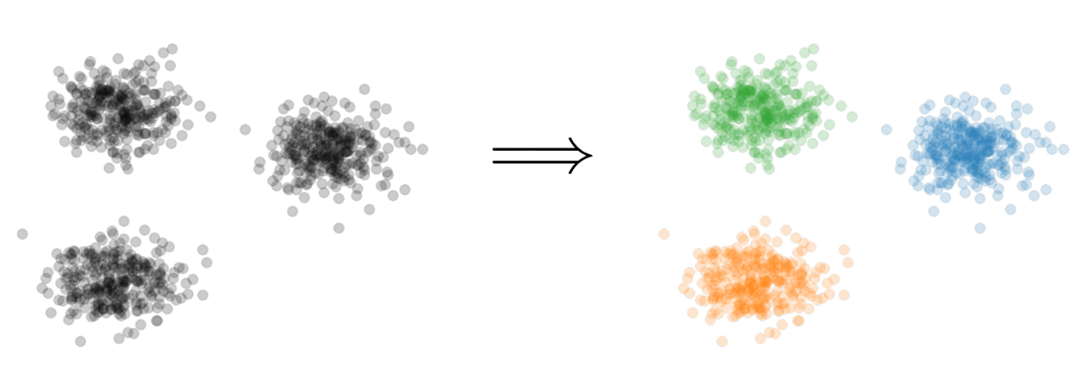
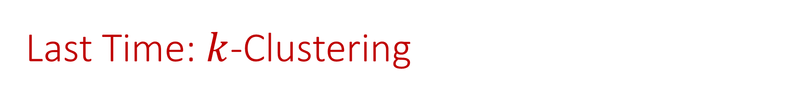
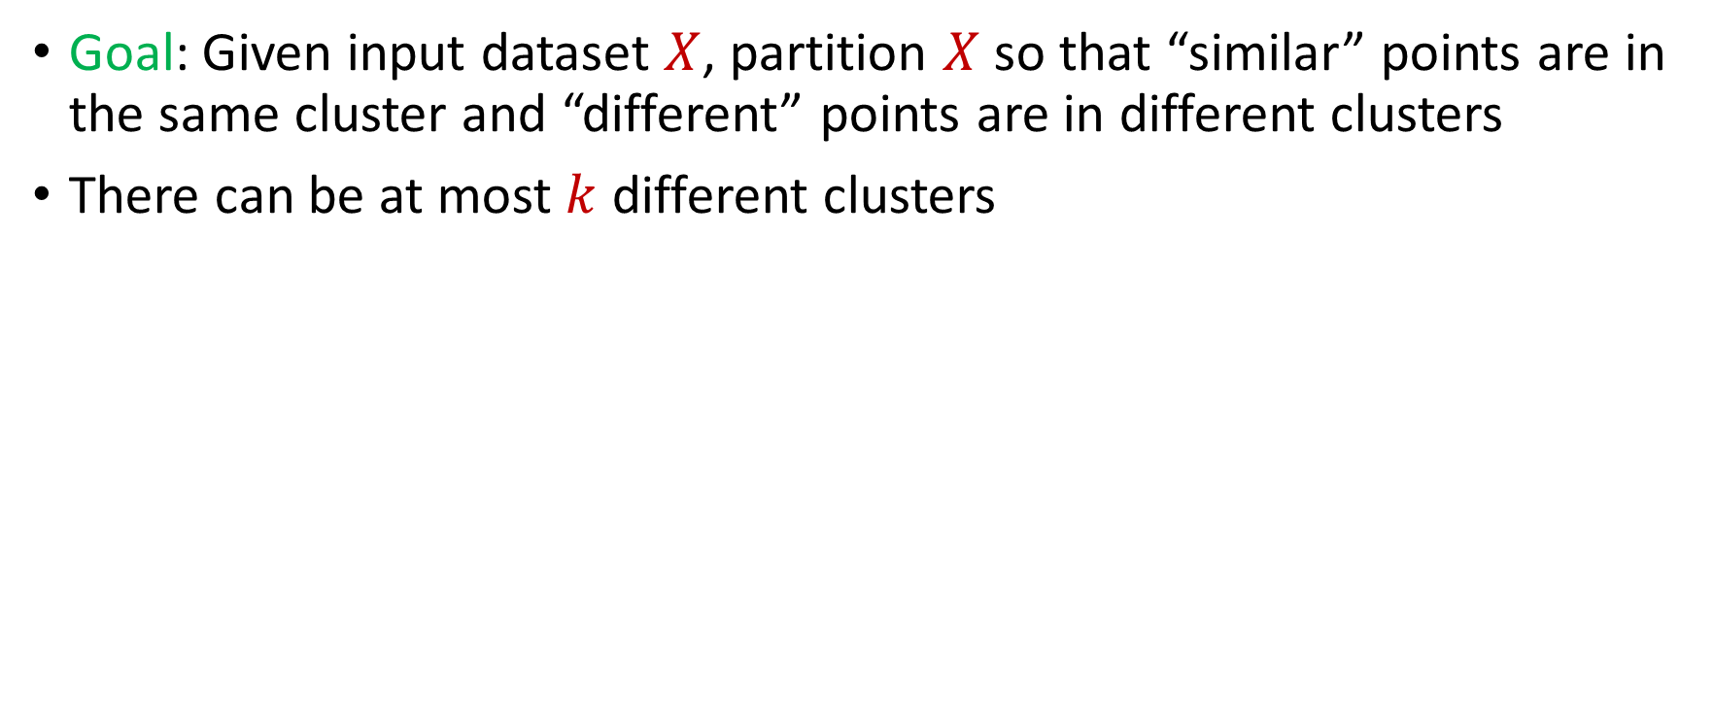
Last Time: $k$-Clustering
Goal: Given input dataset $X$, partition $X$ so that “similar” points are in the same cluster and “different” points are in different clusters
There can be at most $k$ different clusters
$$k=3$$

Slide 5

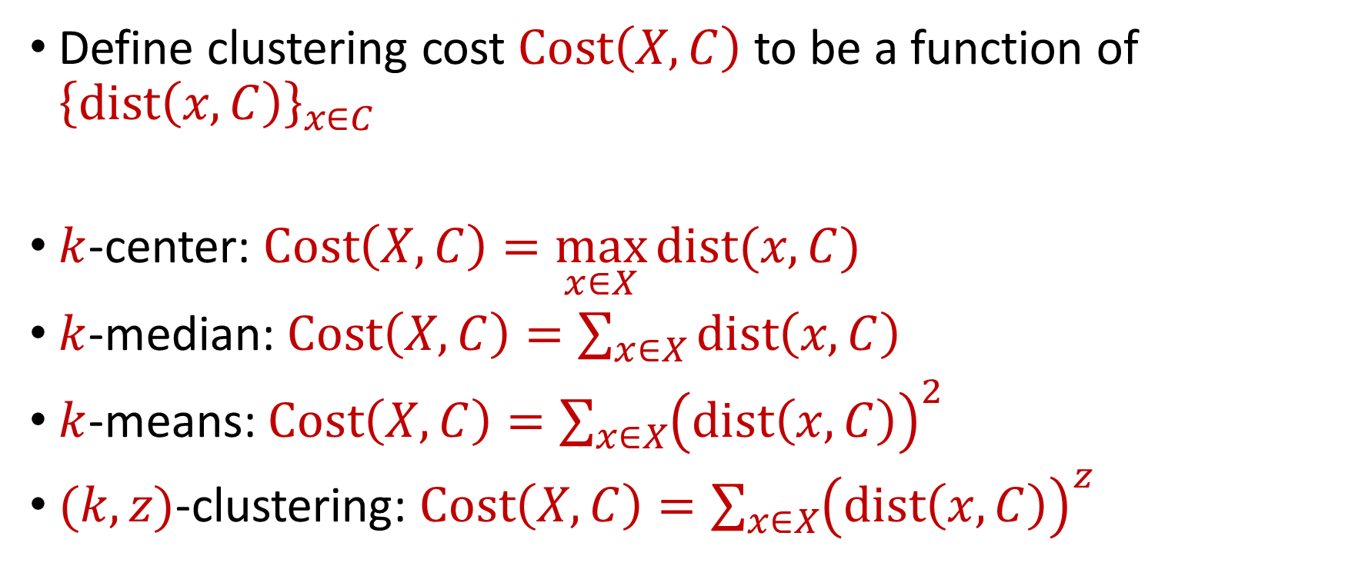






Last Time: $k$-Clustering
Define clustering cost $Cost\left(X,C\right)$ to be a function of ${\left\{dist\left(x,C\right)\right\}}_{x∈C}$
$k$-center: $Cost\left(X,C\right)=\max_{x∈X}{dist(x,C)}$
$k$-median: $Cost\left(X,C\right)=\sum_{x∈X}{dist\left(x,C\right)}$
$k$-means: $Cost\left(X,C\right)=\sum_{x∈X}{{\left(dist\left(x,C\right)\right)}^{2}}$
$(k,z)$-clustering: $Cost\left(X,C\right)=\sum_{x∈X}{{\left(dist\left(x,C\right)\right)}^{z}}$
$${\left(⋅\right)}^{z}$$
$${\left(⋅\right)}^{z}$$
$${\left(⋅\right)}^{z}$$
$${\left(⋅\right)}^{z}$$
$${\left(⋅\right)}^{z}$$
$${\left(⋅\right)}^{z}$$
$${\left(⋅\right)}^{z}$$

Slide 6
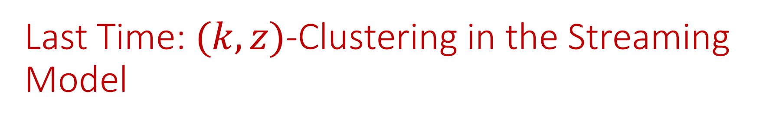
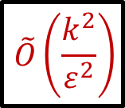
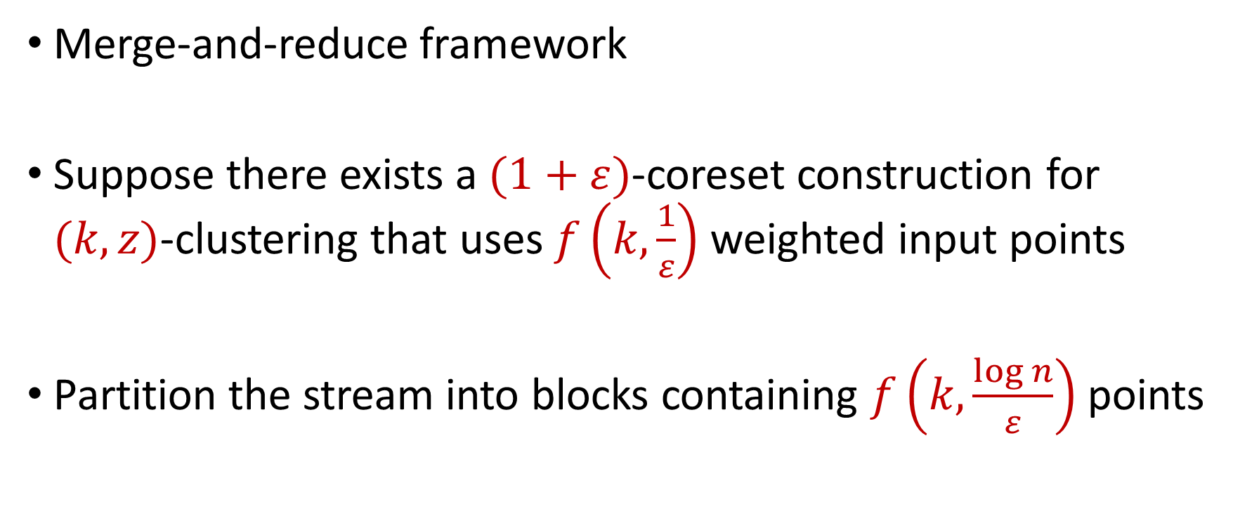
Last Time: $(k,z)$-Clustering in the Streaming Model
Merge-and-reduce framework
Suppose there exists a $(1+ε)$-coreset construction for $(k,z)$-clustering that uses $f\left(k,\frac{1}{ε}\right)$ weighted input points
Partition the stream into blocks containing $f\left(k,\frac{\log{n}}{ε}\right)$ points
$$\tilde{O}\left(\frac{k^{2}}{ε^{2}}\right)$$

Slide 7
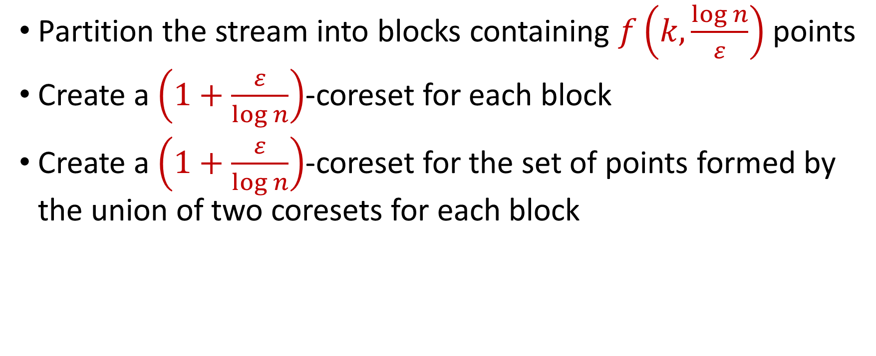
Last Time: $(k,z)$-Clustering in the Streaming Model
Partition the stream into blocks containing $f\left(k,\frac{\log{n}}{ε}\right)$ points
Create a $\left(1+\frac{ε}{\log{n}}\right)$-coreset for each block
Create a $\left(1+\frac{ε}{\log{n}}\right)$-coreset for the set of points formed by the union of two coresets for each block
Reduce
Merge

Slide 8
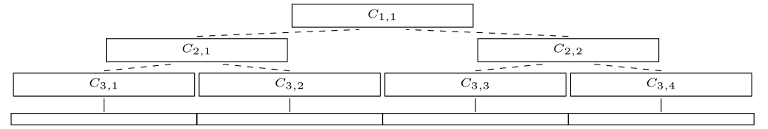
Last Time: $(k,z)$-Clustering in the Streaming Model
Partition the stream into blocks containing $f\left(k,\frac{\log{n}}{ε}\right)$ points
Create a $\left(1+\frac{ε}{\log{n}}\right)$-coreset for each block
Create a $\left(1+\frac{ε}{\log{n}}\right)$-coreset for the set of points formed by the union of two coresets for each block

Slide 9
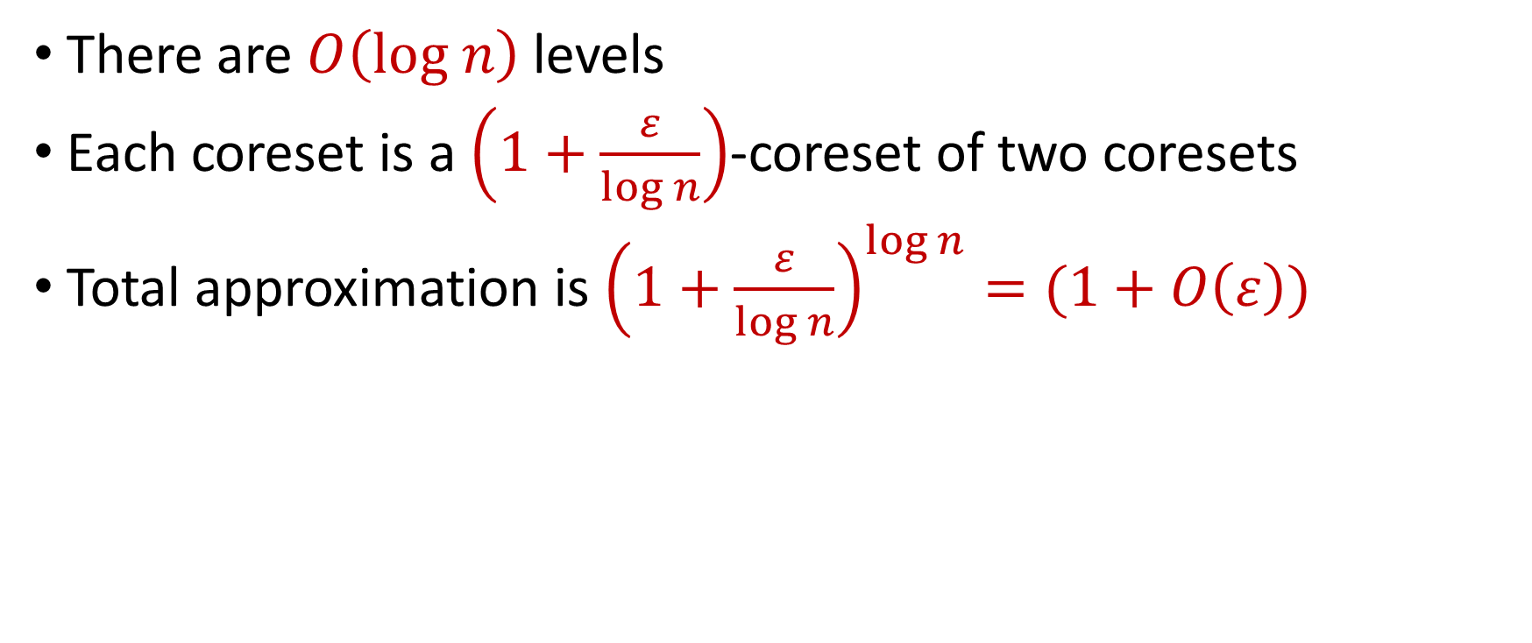
Last Time: $(k,z)$-Clustering in the Streaming Model
There are $O\left(log n\right)$ levels
Each coreset is a $\left(1+\frac{ε}{\log{n}}\right)$-coreset of two coresets
Total approximation is ${\left(1+\frac{ε}{\log{n}}\right)}^{\log{n}}=(1+O\left(ε\right))$

Slide 10

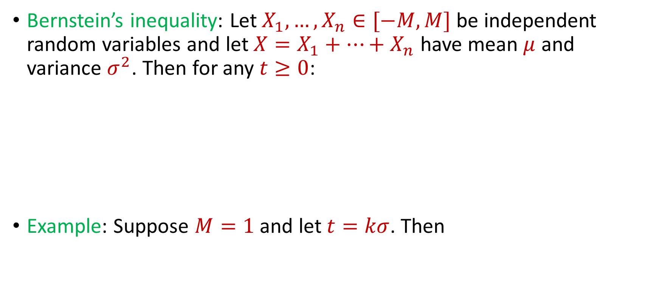
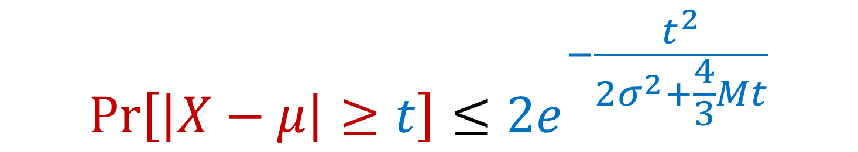
Previously: Bernstein’s Inequality
Bernstein’s inequality: Let $X_{1},…,X_{n}∈[−M,M]$ be independent random variables and let ${X=X}_{1}+…+X_{n}$ have mean $μ$ and variance $σ^{2}$. Then for any $t≥0$:
Example: Suppose $M=1$ and let $t=kσ$. Then
$$Pr\left[\left|X−μ\right|≥t\right]≤2e^{−\frac{t^{2}}{2σ^{2}+\frac{4}{3}Mt}}$$
$$Pr\left[\left|X−μ\right|≥kσ\right]≤2exp\left(−\frac{k^{2}}{4}\right)$$

Slide 11
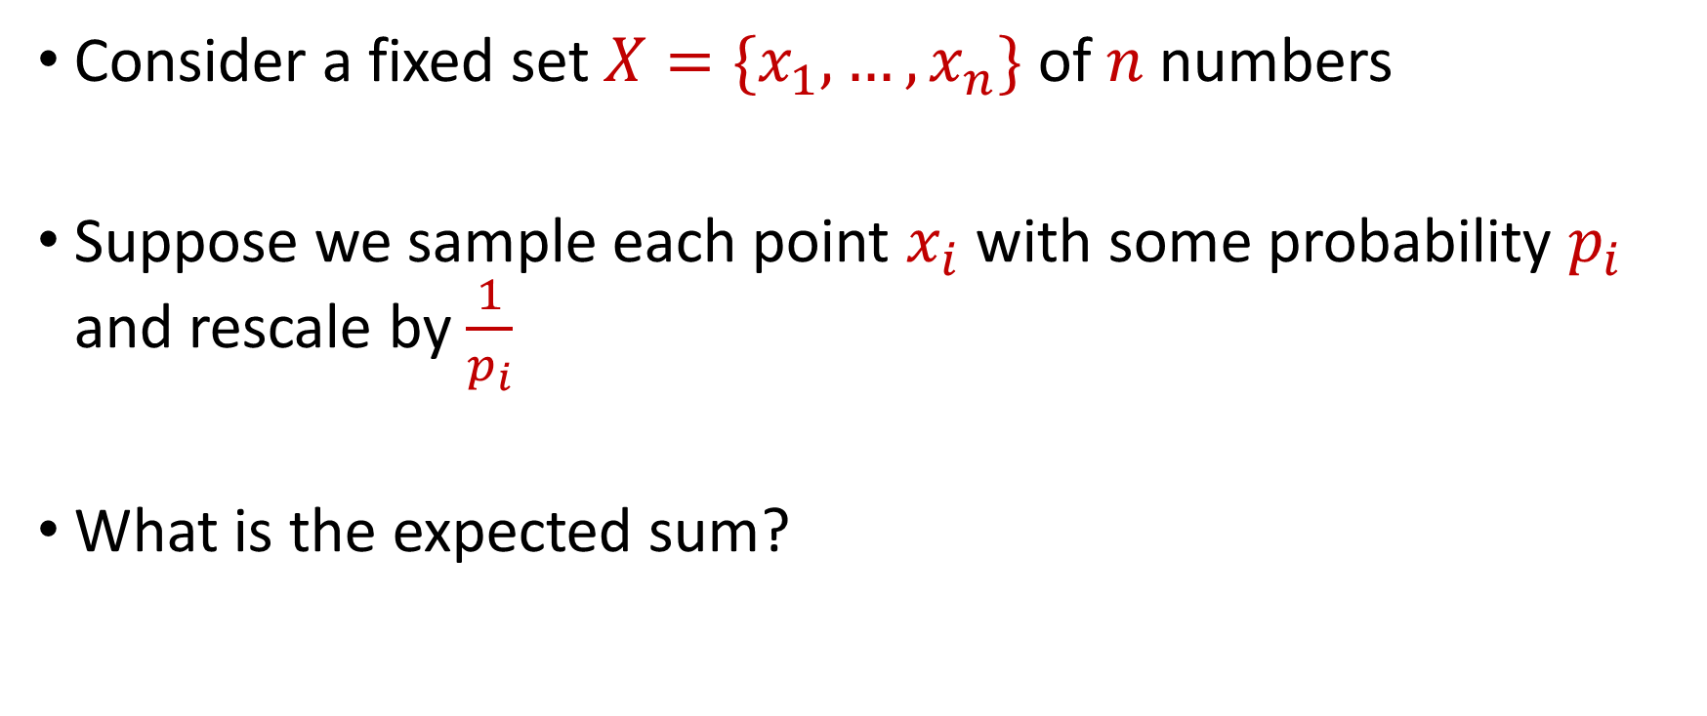
Sampling for Sum Estimation
Consider a fixed set $X=\{x_{1},…,x_{n}\}$ of $n$ numbers
Suppose we sample each point $x_{i}$ with some probability $p_{i}$ and rescale by $\frac{1}{p_{i}}$
What is the expected sum?

Slide 12
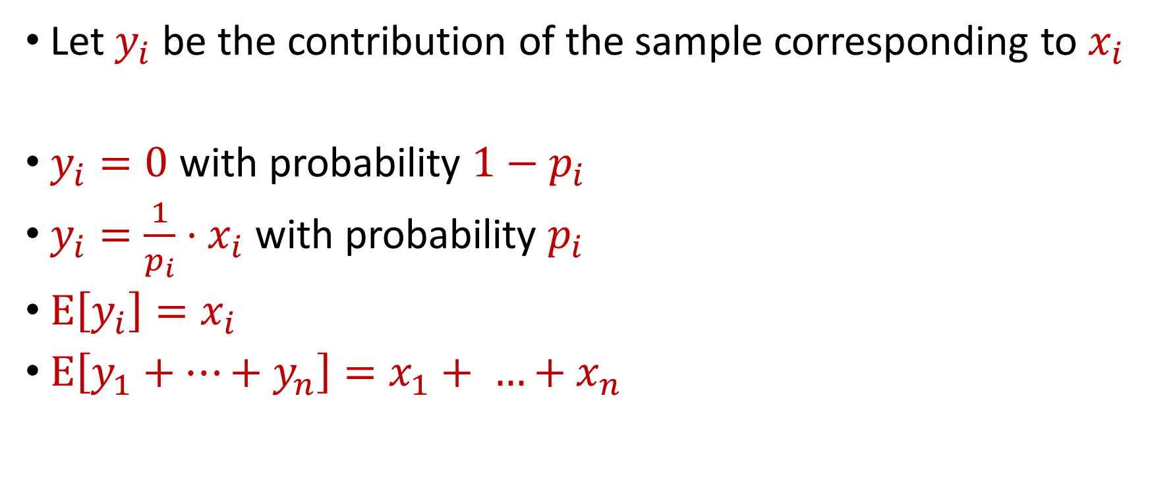
Sampling for Sum Estimation
Let $y_{i}$ be the contribution of the sample corresponding to $x_{i}$
$y_{i}=0$ with probability $1−p_{i}$
$y_{i}=\frac{1}{p_{i}}⋅x_{i}$ with probability $p_{i}$
$E\left[y_{i}\right]=x_{i}$
$E\left[y_{1}+…+y_{n}\right]=x_{1}+ …+x_{n}$

Slide 13
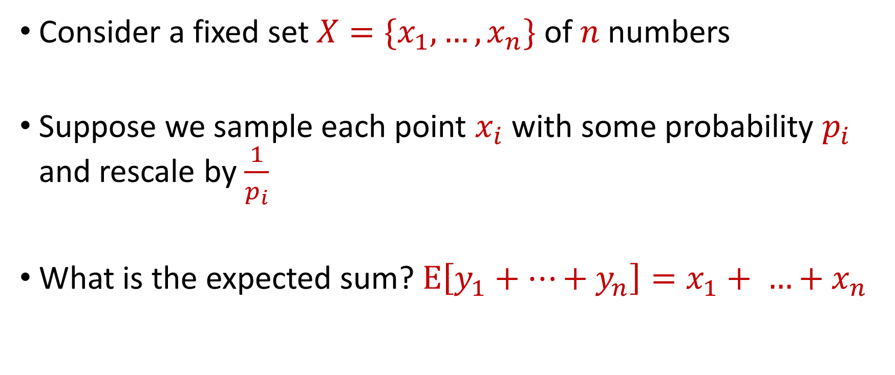
Sampling for Sum Estimation
Consider a fixed set $X=\{x_{1},…,x_{n}\}$ of $n$ numbers
Suppose we sample each point $x_{i}$ with some probability $p_{i}$ and rescale by $\frac{1}{p_{i}}$
What is the expected sum? $E\left[y_{1}+…+y_{n}\right]=x_{1}+ …+x_{n}$

Slide 14
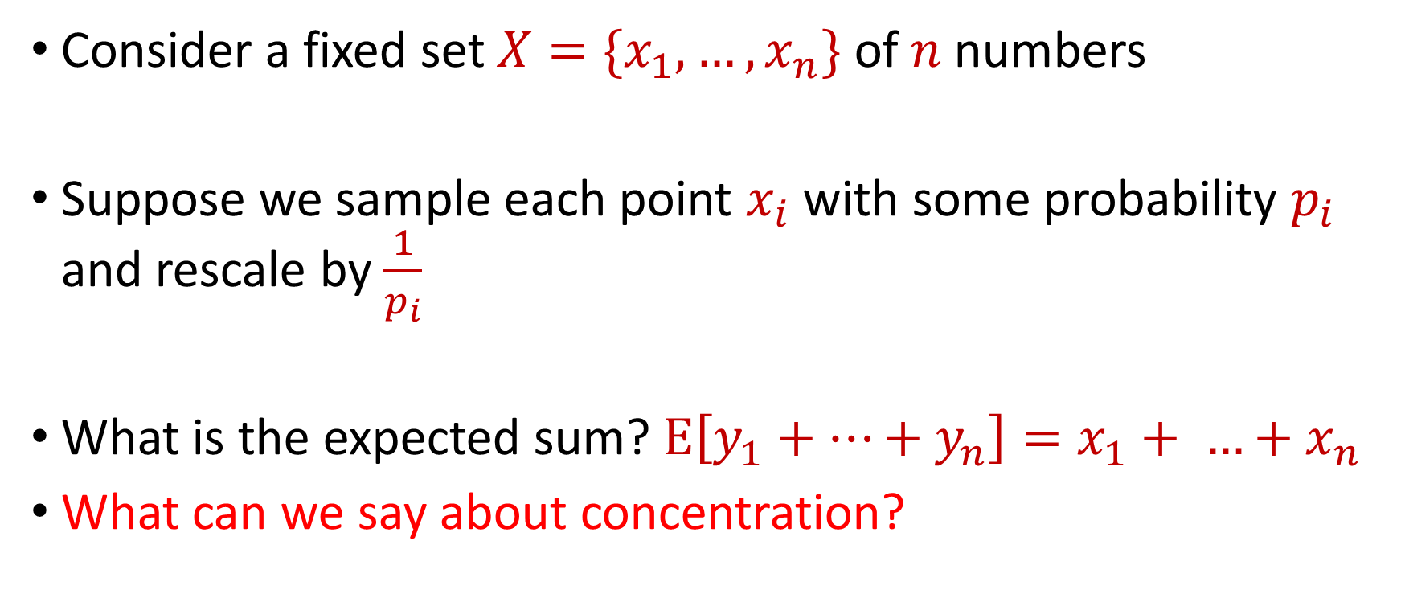
Sampling for Sum Estimation
Consider a fixed set $X=\{x_{1},…,x_{n}\}$ of $n$ numbers
Suppose we sample each point $x_{i}$ with some probability $p_{i}$ and rescale by $\frac{1}{p_{i}}$
What is the expected sum? $E\left[y_{1}+…+y_{n}\right]=x_{1}+ …+x_{n}$
What can we say about concentration?

Slide 15
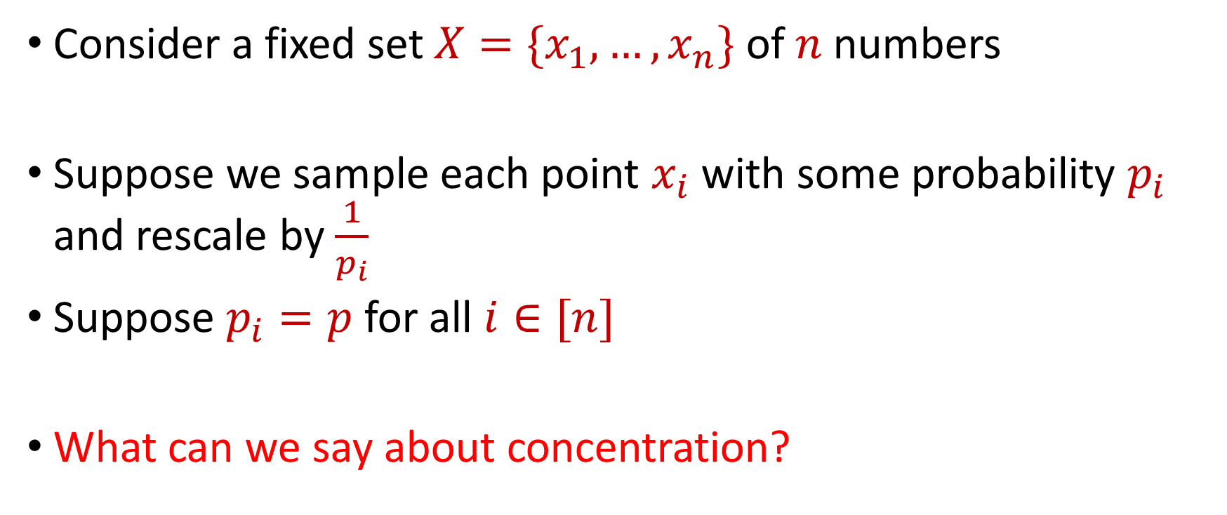
Uniform Sampling for Sum Estimation
Consider a fixed set $X=\{x_{1},…,x_{n}\}$ of $n$ numbers
Suppose we sample each point $x_{i}$ with some probability $p_{i}$ and rescale by $\frac{1}{p_{i}}$
Suppose $p_{i}=p$ for all $i∈[n]$
What can we say about concentration?

Slide 16
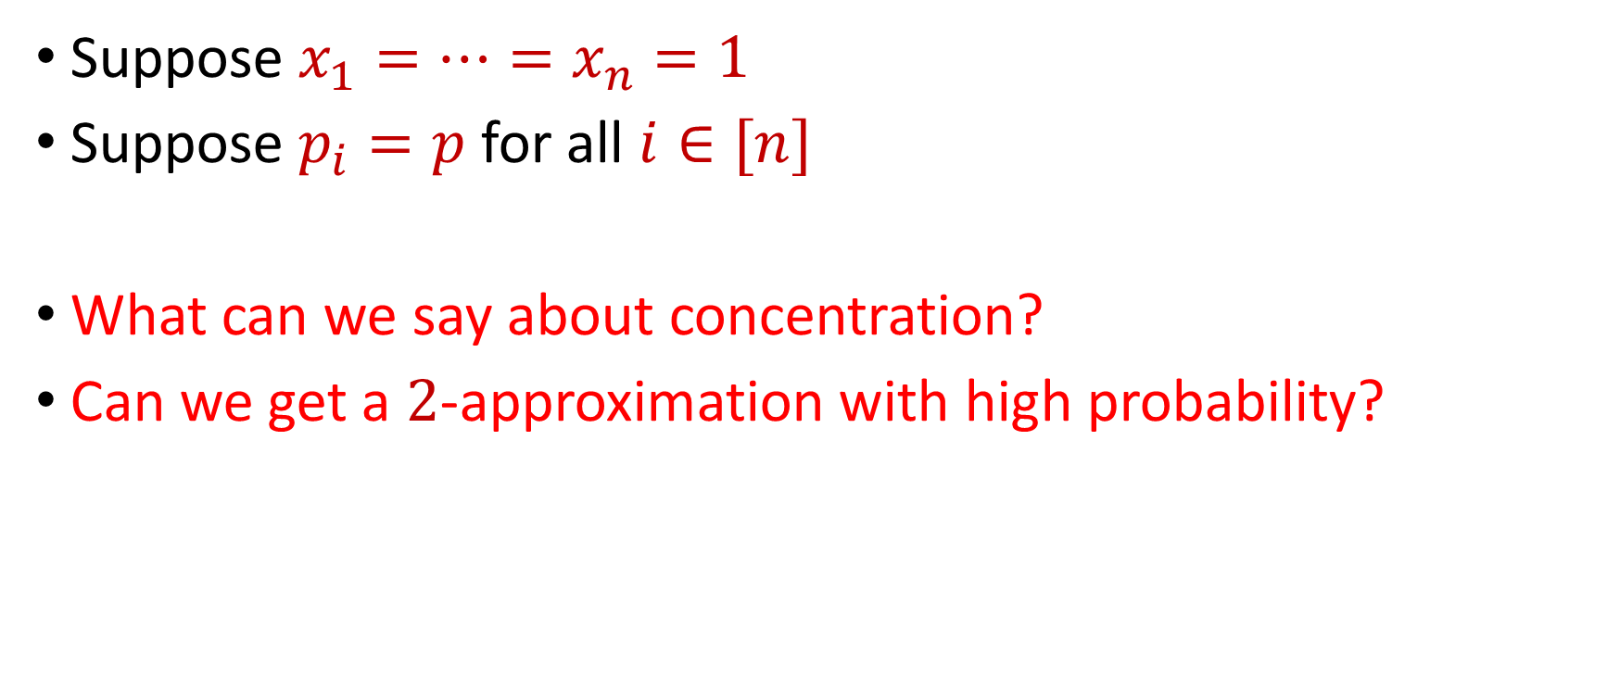
Uniform Sampling for Sum Estimation
Suppose $x_{1}=…=x_{n}=1$
Suppose $p_{i}=p$ for all $i∈[n]$
What can we say about concentration?
Can we get a $2$-approximation with high probability?

Slide 17
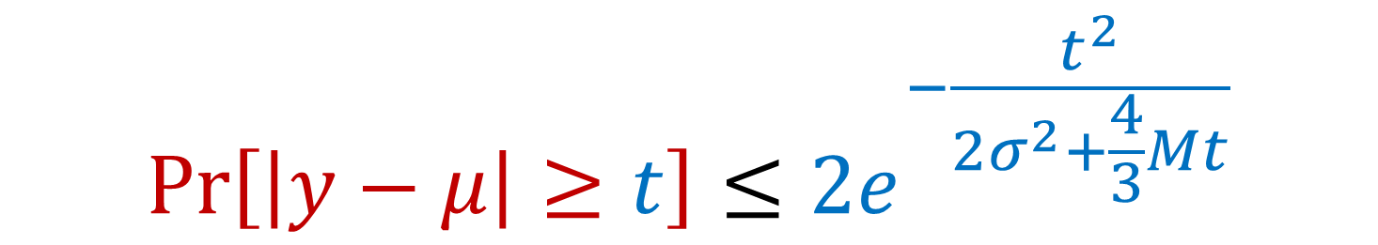
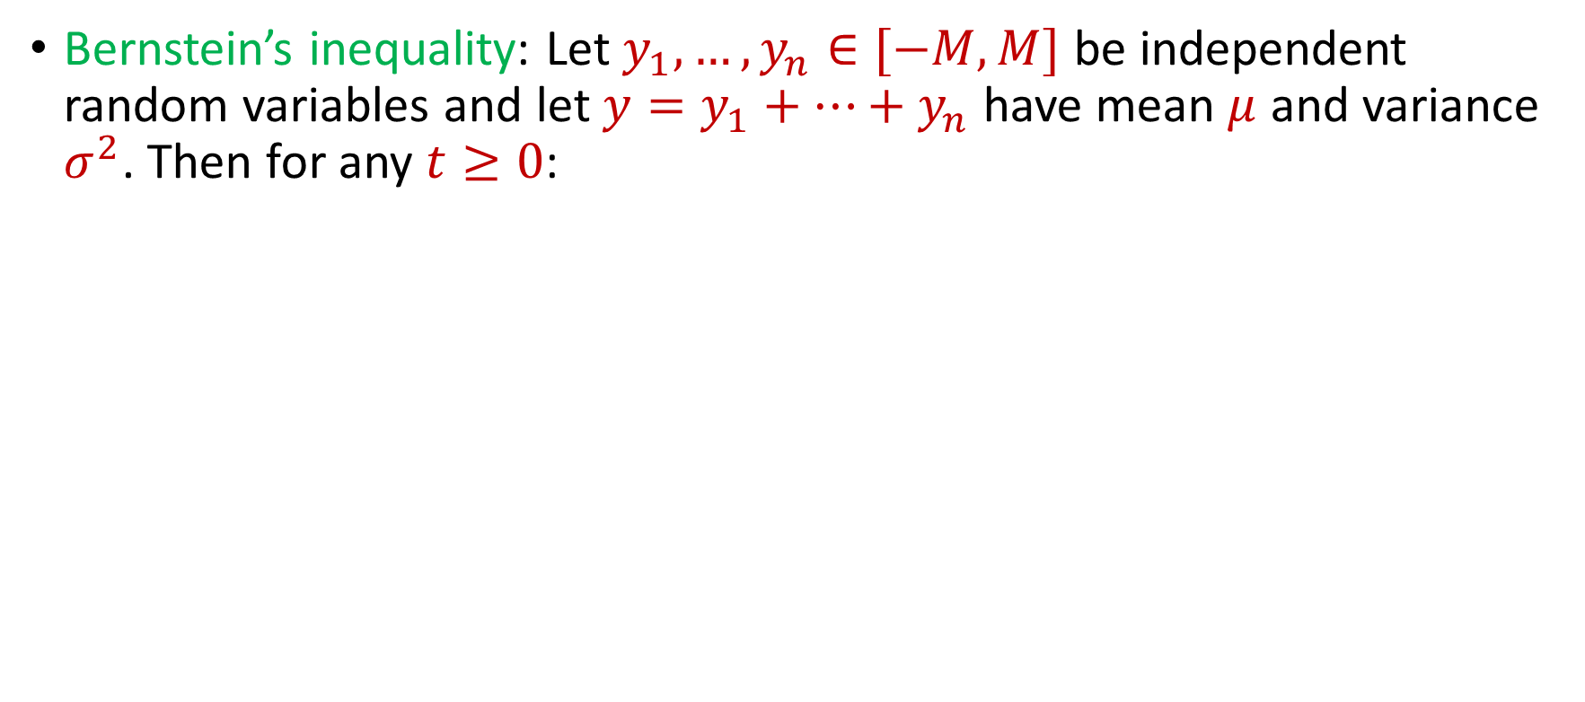
Uniform Sampling for Sum Estimation
Bernstein’s inequality: Let $y_{1},…,y_{n}∈[−M,M]$ be independent random variables and let ${y=y}_{1}+…+y_{n}$ have mean $μ$ and variance $σ^{2}$. Then for any $t≥0$:
$$Pr\left[\left|y−μ\right|≥t\right]≤2e^{−\frac{t^{2}}{2σ^{2}+\frac{4}{3}Mt}}$$

Slide 18
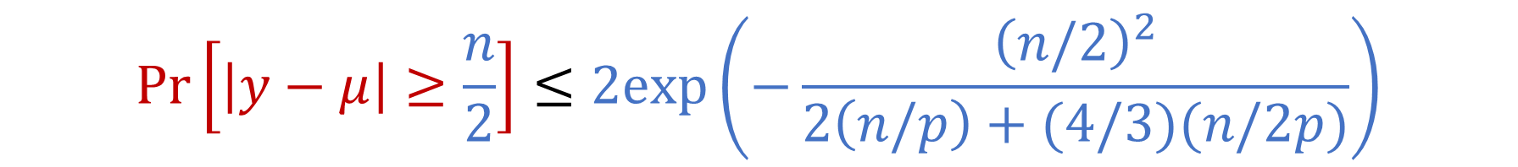
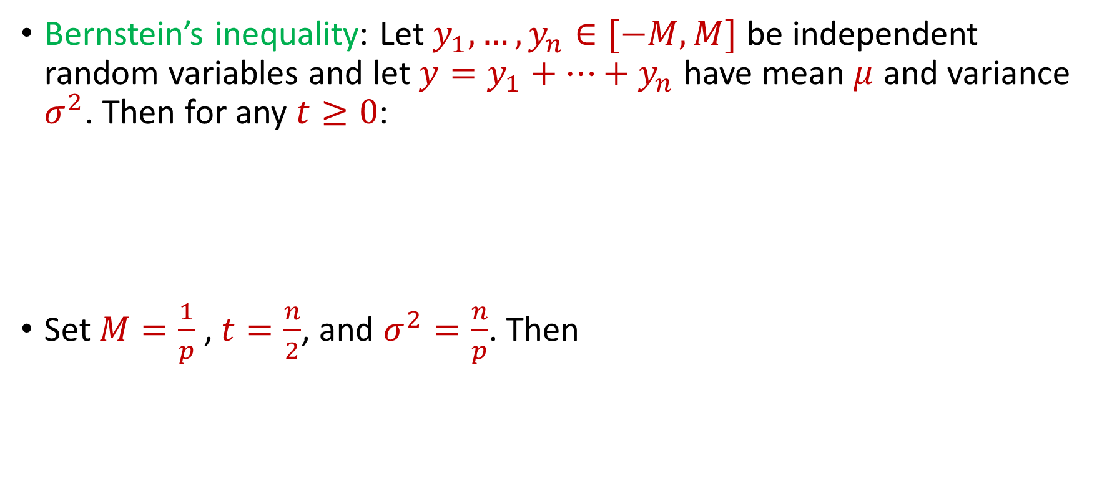
Uniform Sampling for Sum Estimation
Bernstein’s inequality: Let $y_{1},…,y_{n}∈[−M,M]$ be independent random variables and let ${y=y}_{1}+…+y_{n}$ have mean $μ$ and variance $σ^{2}$. Then for any $t≥0$:
Set $M=\frac{1}{p}$ , $t=\frac{n}{2}$, and $σ^{2}=\frac{n}{p}$. Then
$$Pr\left[\left|y−μ\right|≥t\right]≤2e^{−\frac{t^{2}}{2σ^{2}+\frac{4}{3}Mt}}$$
$$Pr\left[\left|y−μ\right|≥\frac{n}{2}\right]≤2exp\left(−\frac{{\left(n/2\right)}^{2}}{2\left(n/p\right)+(4/3)(n/2p)}\right)$$

Slide 19
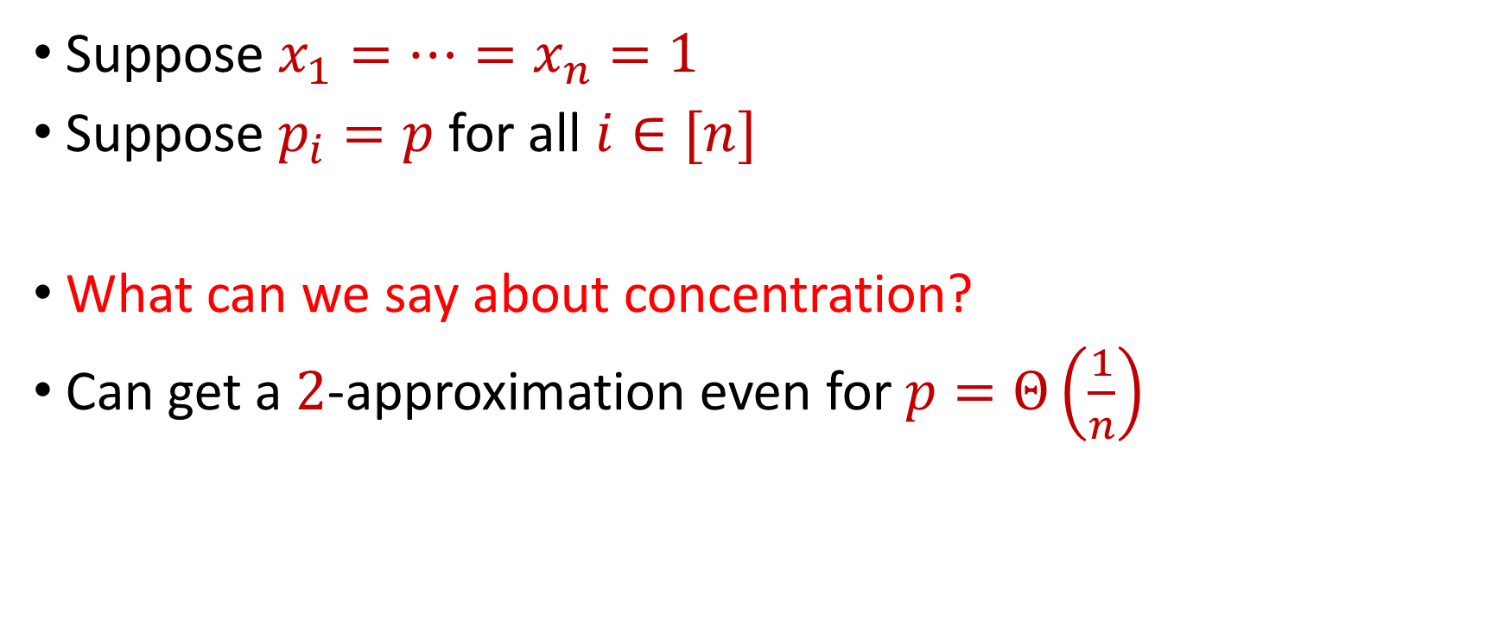
Uniform Sampling for Sum Estimation
Suppose $x_{1}=…=x_{n}=1$
Suppose $p_{i}=p$ for all $i∈[n]$
What can we say about concentration?
Can get a $2$-approximation even for $p=Θ\left(\frac{1}{n}\right)$

Slide 20
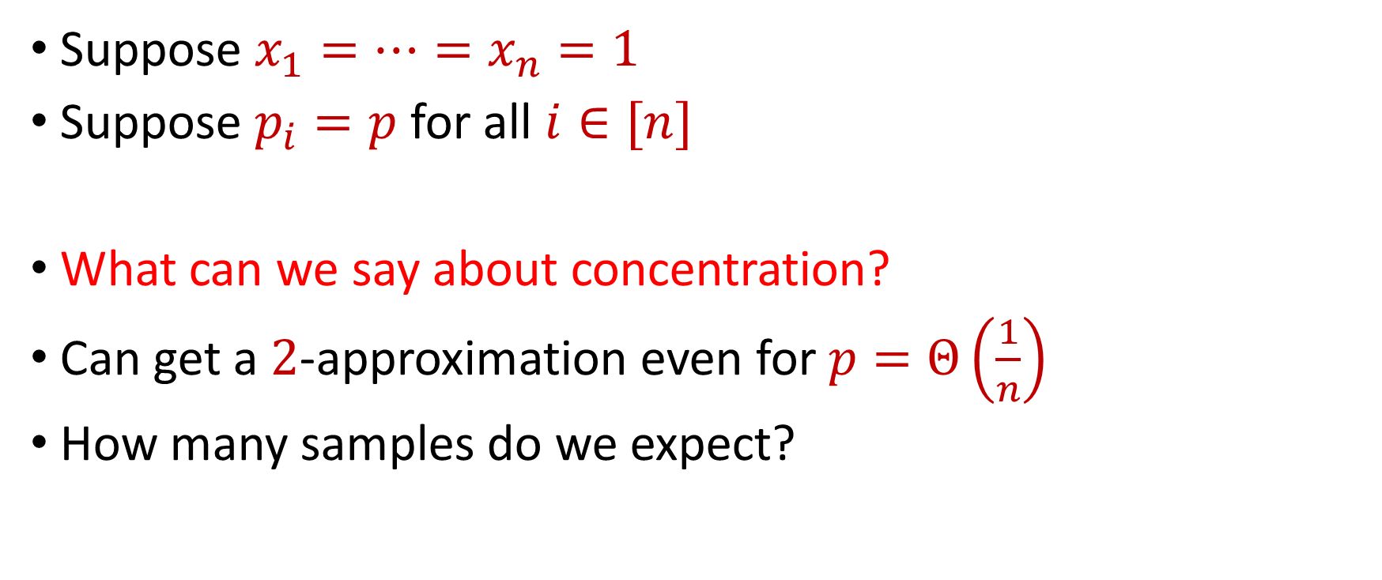
Uniform Sampling for Sum Estimation
Suppose $x_{1}=…=x_{n}=1$
Suppose $p_{i}=p$ for all $i∈[n]$
What can we say about concentration?
Can get a $2$-approximation even for $p=Θ\left(\frac{1}{n}\right)$
How many samples do we expect?

Slide 21
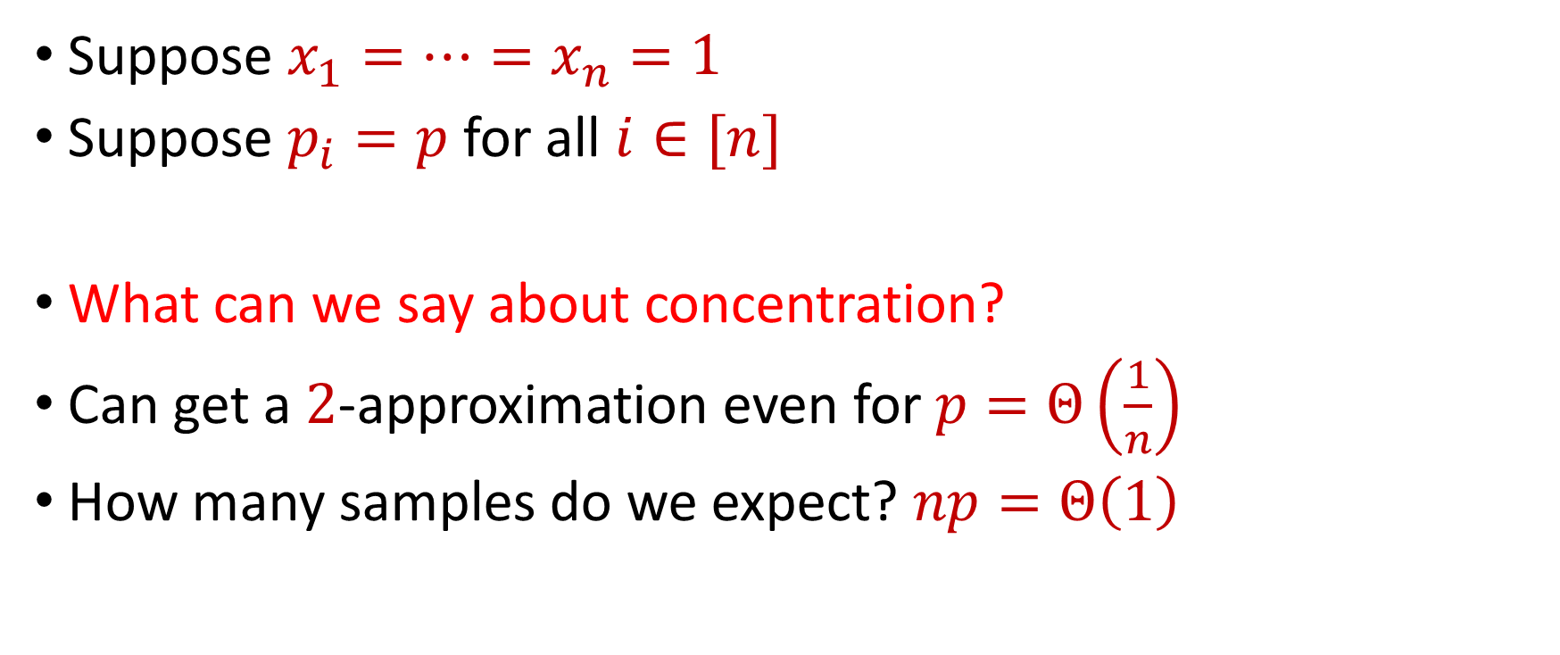
Uniform Sampling for Sum Estimation
Suppose $x_{1}=…=x_{n}=1$
Suppose $p_{i}=p$ for all $i∈[n]$
What can we say about concentration?
Can get a $2$-approximation even for $p=Θ\left(\frac{1}{n}\right)$
How many samples do we expect? $np=Θ\left(1\right)$

Slide 22
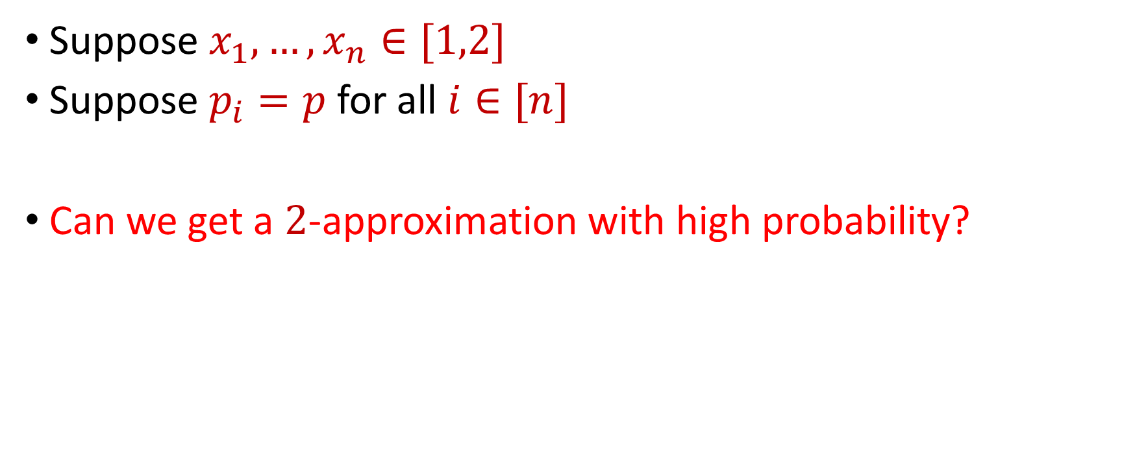
Uniform Sampling for Sum Estimation
Suppose $x_{1},…,x_{n}∈[1,2]$
Suppose $p_{i}=p$ for all $i∈[n]$
Can we get a $2$-approximation with high probability?

Slide 23


Uniform Sampling for Sum Estimation
Bernstein’s inequality: Let $y_{1},…,y_{n}∈[−M,M]$ be independent random variables and let ${y=y}_{1}+…+y_{n}$ have mean $μ$ and variance $σ^{2}$. Then for any $t≥0$:
Set $M=\frac{2}{p}$ , $t=\frac{x}{2}$, and $σ^{2}≈\frac{4n}{p}$. Then
$$Pr\left[\left|y−μ\right|≥t\right]≤2e^{−\frac{t^{2}}{2σ^{2}+\frac{4}{3}Mt}}$$
$$Pr\left[\left|y−μ\right|≥\frac{x}{2}\right]≤2exp\left(−\frac{{\left(x/2\right)}^{2}}{2\left(4n/p\right)+(4/3)(x/p)}\right)$$

Slide 24
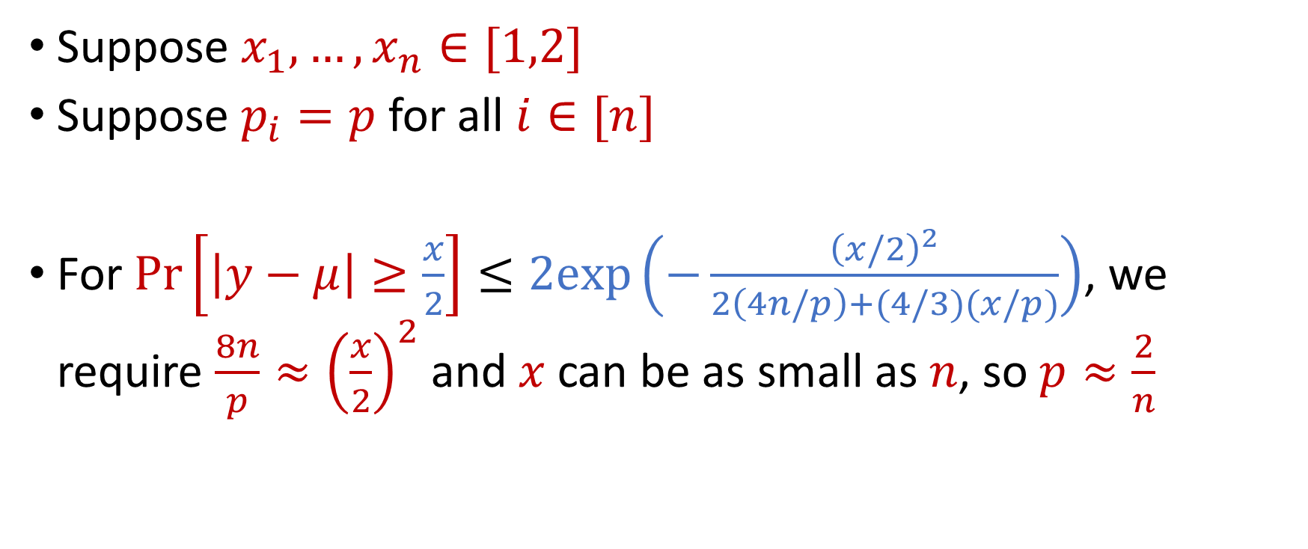
Uniform Sampling for Sum Estimation
Suppose $x_{1},…,x_{n}∈[1,2]$
Suppose $p_{i}=p$ for all $i∈[n]$
For $Pr\left[\left|y−μ\right|≥\frac{x}{2}\right]≤2exp\left(−\frac{{\left(x/2\right)}^{2}}{2\left(4n/p\right)+(4/3)(x/p)}\right)$, we require $\frac{8n}{p}≈{\left(\frac{x}{2}\right)}^{2}$ and $x$ can be as small as $n$, so $p≈\frac{2}{n}$

Slide 25
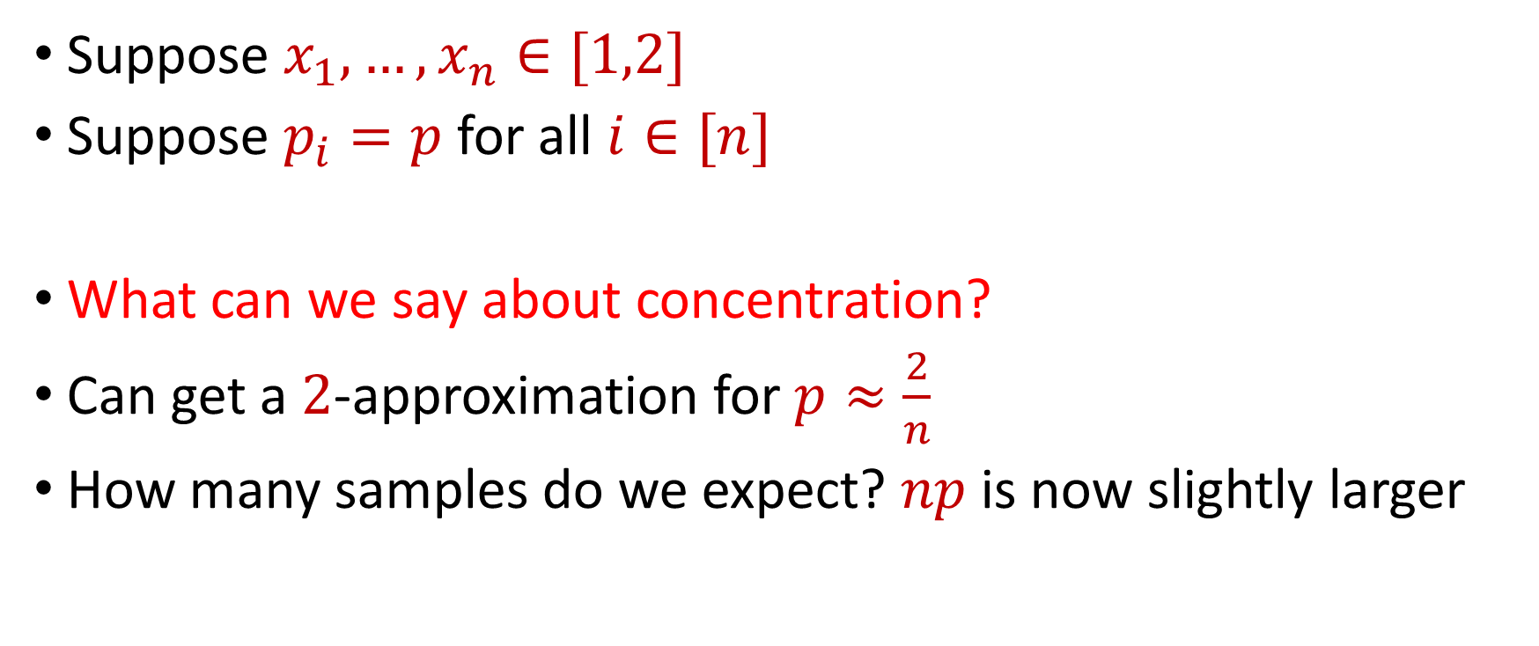
Uniform Sampling for Sum Estimation
Suppose $x_{1},…,x_{n}∈[1,2]$
Suppose $p_{i}=p$ for all $i∈[n]$
What can we say about concentration?
Can get a $2$-approximation for $p≈\frac{2}{n}$
How many samples do we expect? $np$ is now slightly larger

Slide 26
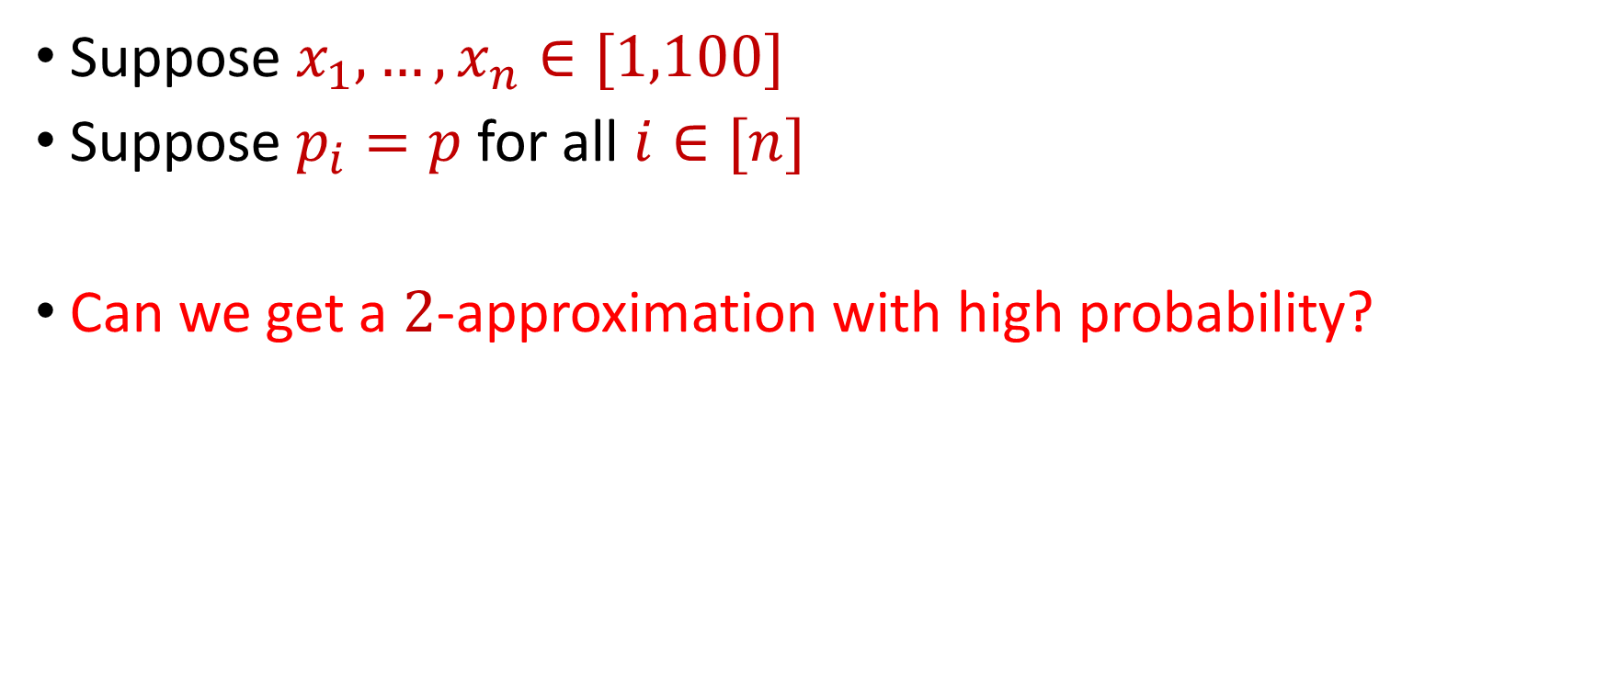
Uniform Sampling for Sum Estimation
Suppose $x_{1},…,x_{n}∈[1,100]$
Suppose $p_{i}=p$ for all $i∈[n]$
Can we get a $2$-approximation with high probability?

Slide 27
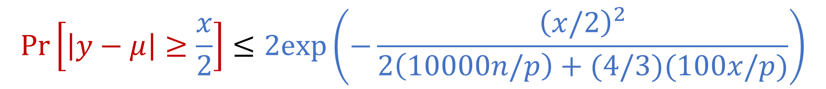
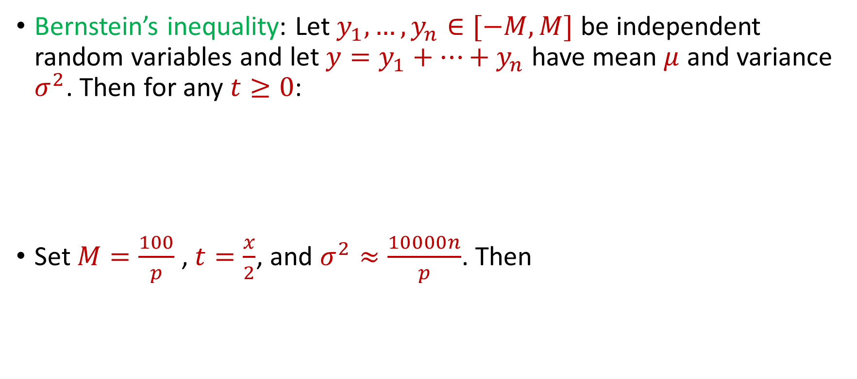
Uniform Sampling for Sum Estimation
Bernstein’s inequality: Let $y_{1},…,y_{n}∈[−M,M]$ be independent random variables and let ${y=y}_{1}+…+y_{n}$ have mean $μ$ and variance $σ^{2}$. Then for any $t≥0$:
Set $M=\frac{100}{p}$ , $t=\frac{x}{2}$, and $σ^{2}≈\frac{10000n}{p}$. Then
$$Pr\left[\left|y−μ\right|≥t\right]≤2e^{−\frac{t^{2}}{2σ^{2}+\frac{4}{3}Mt}}$$
$$Pr\left[\left|y−μ\right|≥\frac{x}{2}\right]≤2exp\left(−\frac{{\left(x/2\right)}^{2}}{2\left(10000n/p\right)+(4/3)(100x/p)}\right)$$

Slide 28
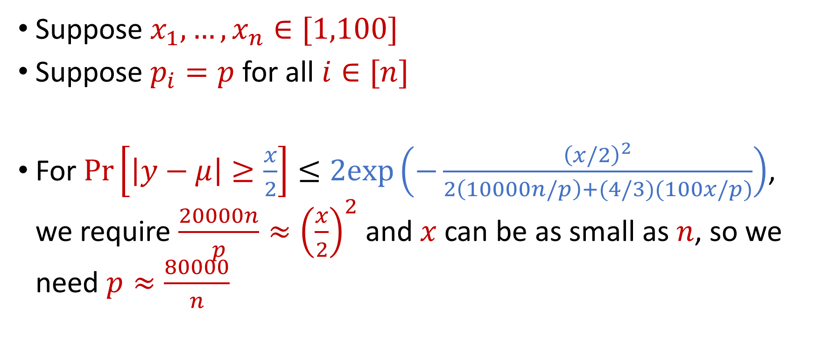
Uniform Sampling for Sum Estimation
Suppose $x_{1},…,x_{n}∈[1,100]$
Suppose $p_{i}=p$ for all $i∈[n]$
For $Pr\left[\left|y−μ\right|≥\frac{x}{2}\right]≤2exp\left(−\frac{{\left(x/2\right)}^{2}}{2\left(10000n/p\right)+(4/3)(100x/p)}\right)$, we require $\frac{20000n}{p}≈{\left(\frac{x}{2}\right)}^{2}$ and $x$ can be as small as $n$, so we need $p≈\frac{80000}{n}$

Slide 29
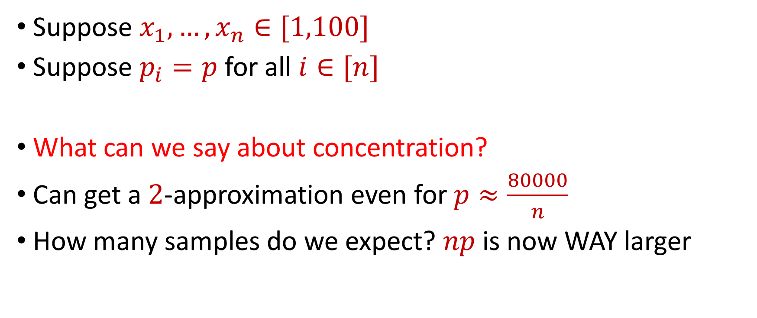
Uniform Sampling for Sum Estimation
Suppose $x_{1},…,x_{n}∈[1,100]$
Suppose $p_{i}=p$ for all $i∈[n]$
What can we say about concentration?
Can get a $2$-approximation even for $p≈\frac{80000}{n}$
How many samples do we expect? $np$ is now WAY larger

Slide 30

Uniform Sampling for Sum Estimation
Suppose $x_{1},…,x_{n}∈[1,n]$
Suppose $p_{i}=p$ for all $i∈[n]$
Can we get a $2$-approximation with high probability?

Slide 31


Uniform Sampling for Sum Estimation
Bernstein’s inequality: Let $y_{1},…,y_{n}∈[−M,M]$ be independent random variables and let ${y=y}_{1}+…+y_{n}$ have mean $μ$ and variance $σ^{2}$. Then for any $t≥0$:
Set $M=\frac{n}{p}$ , $t=\frac{x}{2}$, and $σ^{2}≈\frac{n^{2}}{p}$. Then
$$Pr\left[\left|y−μ\right|≥t\right]≤2e^{−\frac{t^{2}}{2σ^{2}+\frac{4}{3}Mt}}$$
$$Pr\left[\left|y−μ\right|≥\frac{x}{2}\right]≤2exp\left(−\frac{{\left(x/2\right)}^{2}}{2\left(n^{2}/p\right)+(4/3)(nx/2p)}\right)$$

Slide 32
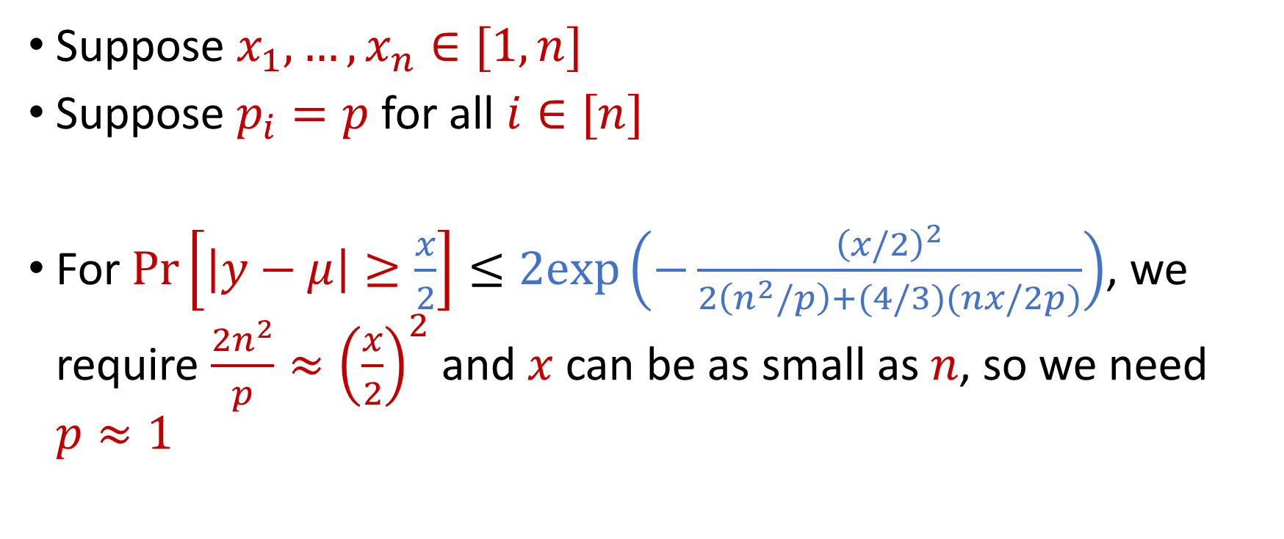
Uniform Sampling for Sum Estimation
Suppose $x_{1},…,x_{n}∈[1,n]$
Suppose $p_{i}=p$ for all $i∈[n]$
For $Pr\left[\left|y−μ\right|≥\frac{x}{2}\right]≤2exp\left(−\frac{{\left(x/2\right)}^{2}}{2\left(n^{2}/p\right)+(4/3)(nx/2p)}\right)$, we require $\frac{2n^{2}}{p}≈{\left(\frac{x}{2}\right)}^{2}$ and $x$ can be as small as $n$, so we need $p≈1$

Slide 33
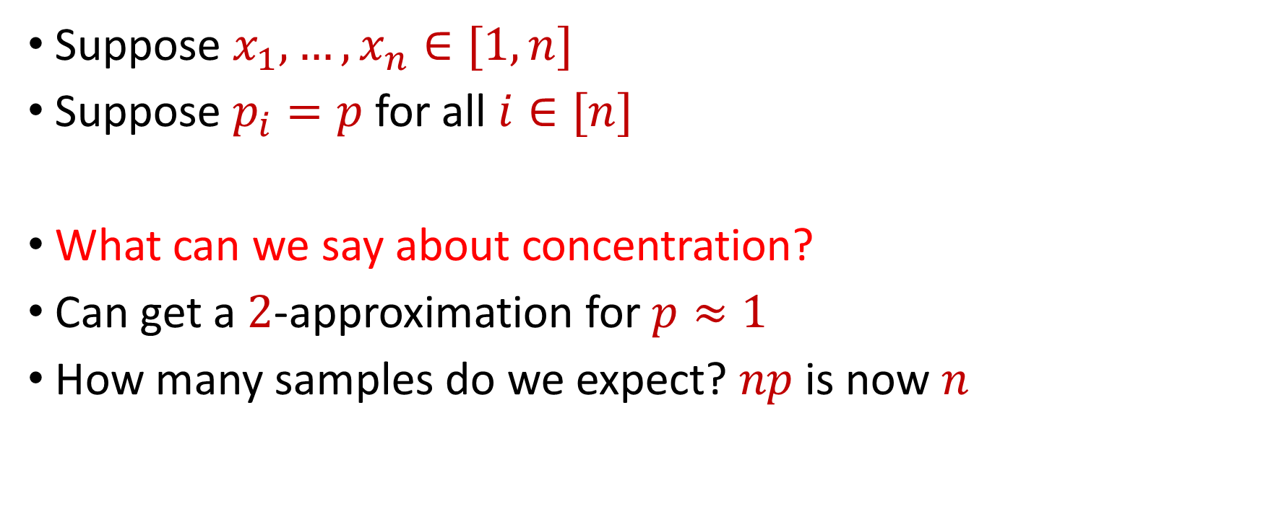
Uniform Sampling for Sum Estimation
Suppose $x_{1},…,x_{n}∈[1,n]$
Suppose $p_{i}=p$ for all $i∈[n]$
What can we say about concentration?
Can get a $2$-approximation for $p≈1$
How many samples do we expect? $np$ is now $n$

Slide 34
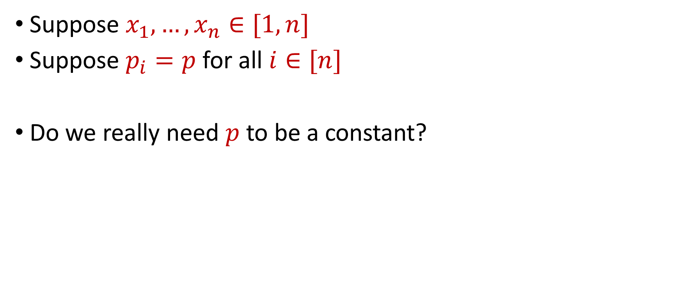
Uniform Sampling for Sum Estimation
Suppose $x_{1},…,x_{n}∈[1,n]$
Suppose $p_{i}=p$ for all $i∈[n]$
Do we really need $p$ to be a constant?

Slide 35
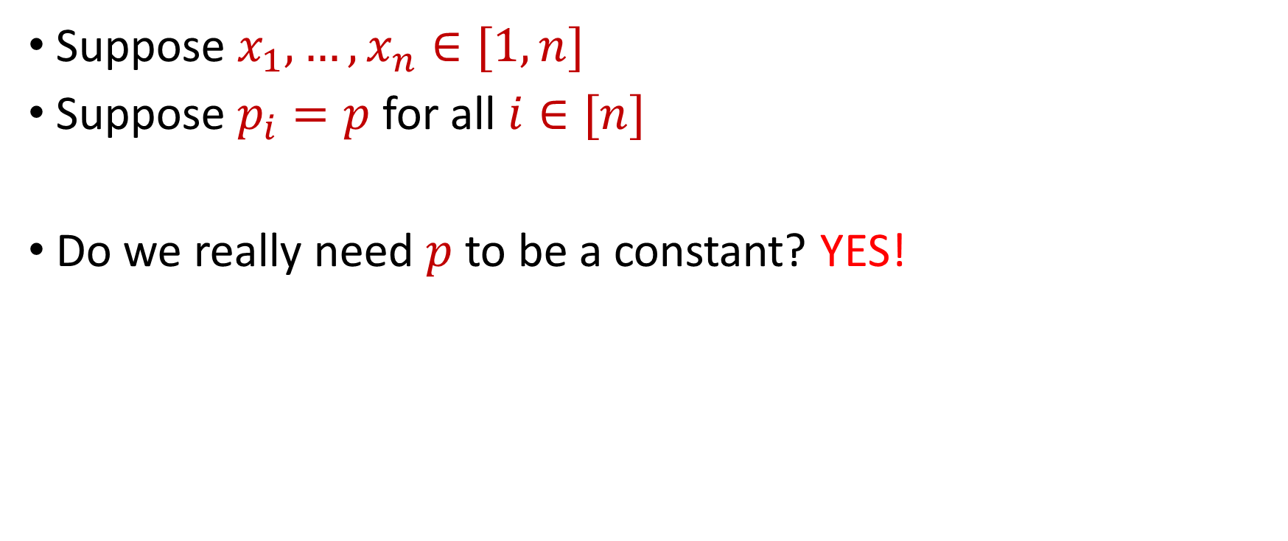
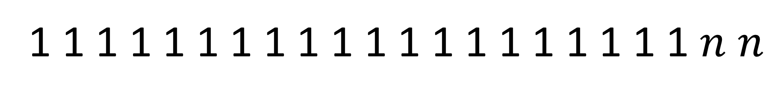
Uniform Sampling for Sum Estimation
Suppose $x_{1},…,x_{n}∈[1,n]$
Suppose $p_{i}=p$ for all $i∈[n]$
Do we really need $p$ to be a constant? YES!
1 1 1 1 1 1 1 1 1 1 1 1 1 1 1 1 1 1 1 1 $n$ $n$

Slide 36
Sampling for Sum Estimation
Consider a fixed set $X=\{x_{1},…,x_{n}\}$ of $n$ numbers
Suppose we sample each point $x_{i}$ with some probability $p_{i}$ and rescale by $\frac{1}{p_{i}}$
What is the expected sum? $E\left[y_{1}+…+y_{n}\right]=x_{1}+ …+x_{n}$
What can we say about concentration?

Slide 37
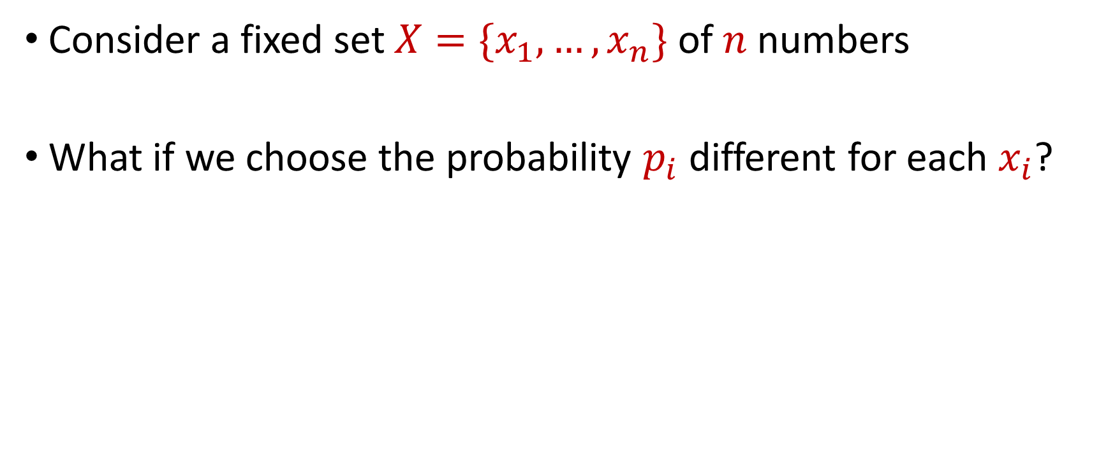
Sampling for Sum Estimation
Consider a fixed set $X=\{x_{1},…,x_{n}\}$ of $n$ numbers
What if we choose the probability $p_{i}$ different for each $x_{i}$?

Slide 38
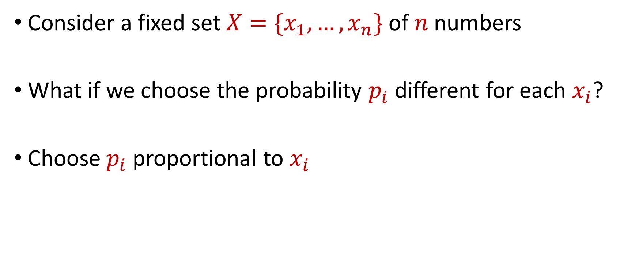
Sampling for Sum Estimation
Consider a fixed set $X=\{x_{1},…,x_{n}\}$ of $n$ numbers
What if we choose the probability $p_{i}$ different for each $x_{i}$?
Choose $p_{i}$ proportional to $x_{i}$

Slide 39
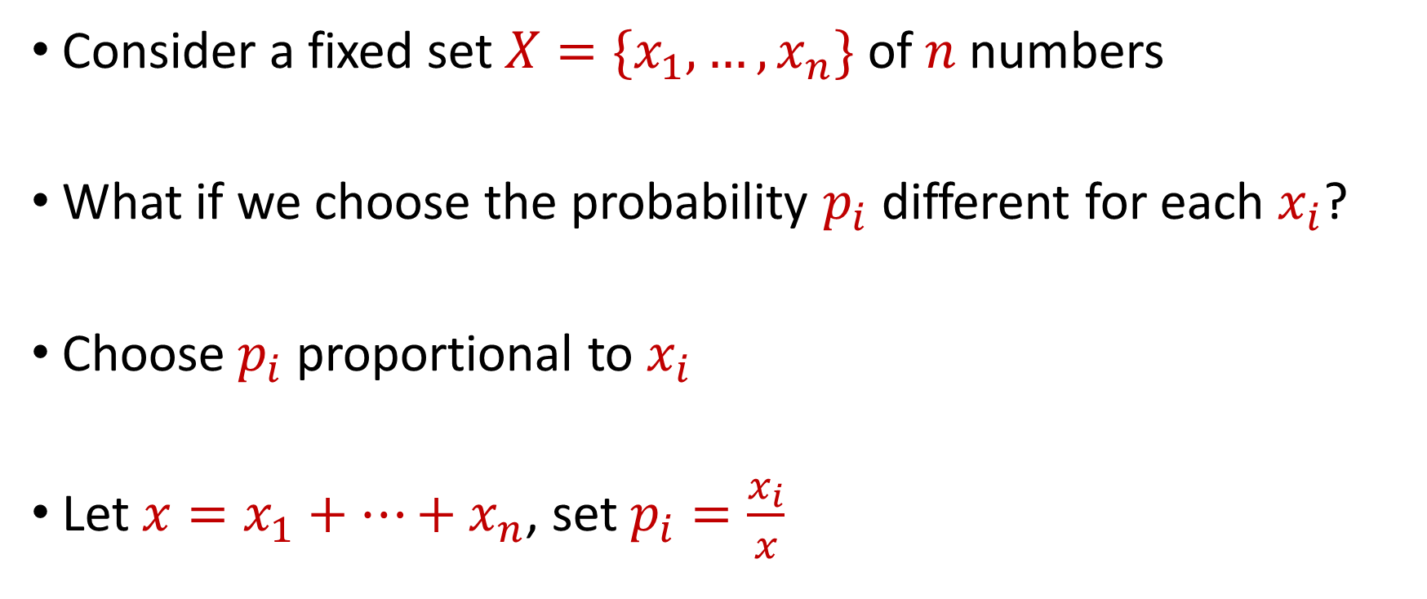
Importance Sampling for Sum Estimation
Consider a fixed set $X=\{x_{1},…,x_{n}\}$ of $n$ numbers
What if we choose the probability $p_{i}$ different for each $x_{i}$?
Choose $p_{i}$ proportional to $x_{i}$
Let $x=x_{1}+…+x_{n}$, set $p_{i}=\frac{x_{i}}{x}$

Slide 40
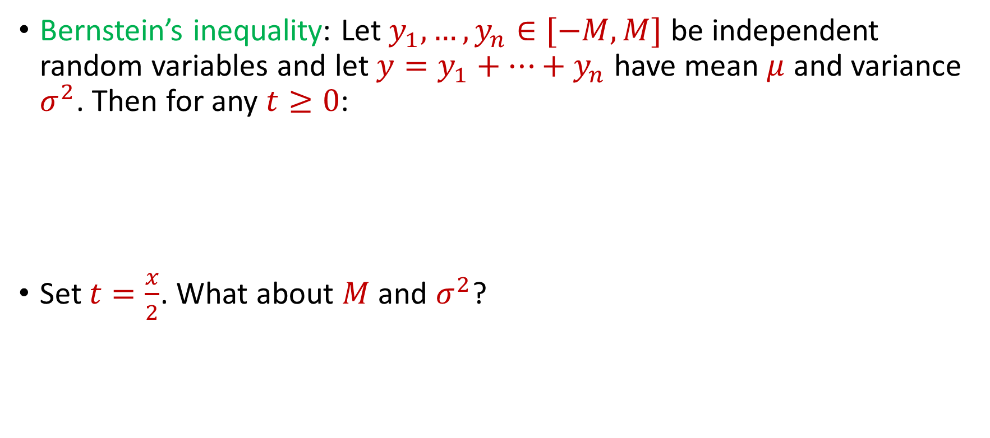
Importance Sampling for Sum Estimation
Bernstein’s inequality: Let $y_{1},…,y_{n}∈[−M,M]$ be independent random variables and let ${y=y}_{1}+…+y_{n}$ have mean $μ$ and variance $σ^{2}$. Then for any $t≥0$:
Set $t=\frac{x}{2}$. What about $M$and $σ^{2}$?
$$Pr\left[\left|y−μ\right|≥t\right]≤2e^{−\frac{t^{2}}{2σ^{2}+\frac{4}{3}Mt}}$$

Slide 41
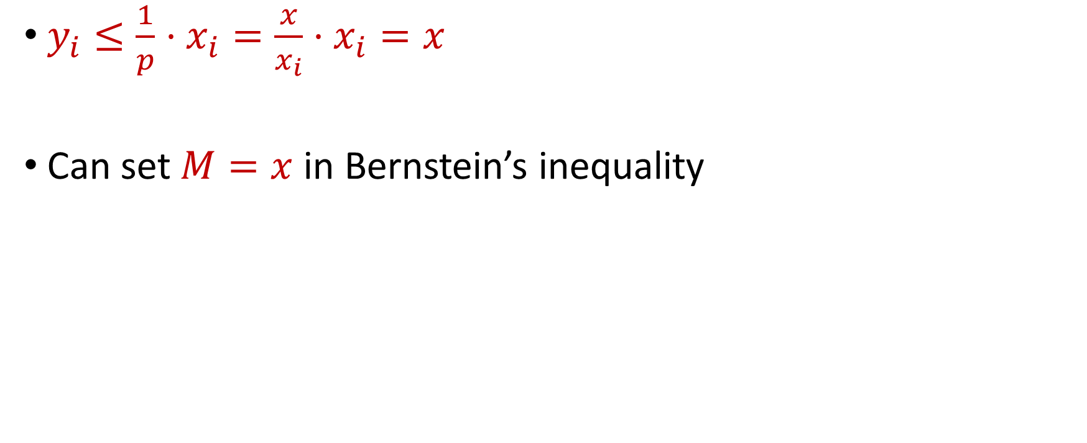
Importance Sampling for Sum Estimation
$y_{i}≤\frac{1}{p}⋅x_{i}=\frac{x}{x_{i}}⋅x_{i}=x$
Can set $M=x$ in Bernstein’s inequality

Slide 42
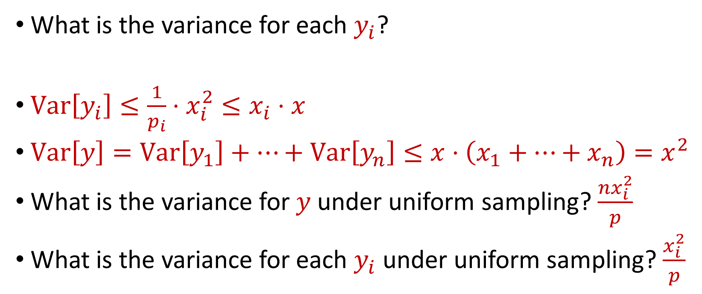
Importance Sampling for Sum Estimation
What is the variance for each $y_{i}$?
$Var\left[y_{i}\right]≤\frac{1}{p_{i}}⋅x_{i}^{2}≤x_{i}⋅x$
$Var\left[y\right]=Var\left[y_{1}\right]+…+Var\left[y_{n}\right]≤x⋅\left(x_{1}+…+x_{n}\right)=x^{2}$
What is the variance for $y$under uniform sampling? $\frac{{nx}_{i}^{2}}{p}$
What is the variance for each $y_{i}$ under uniform sampling? $\frac{x_{i}^{2}}{p}$

Slide 43

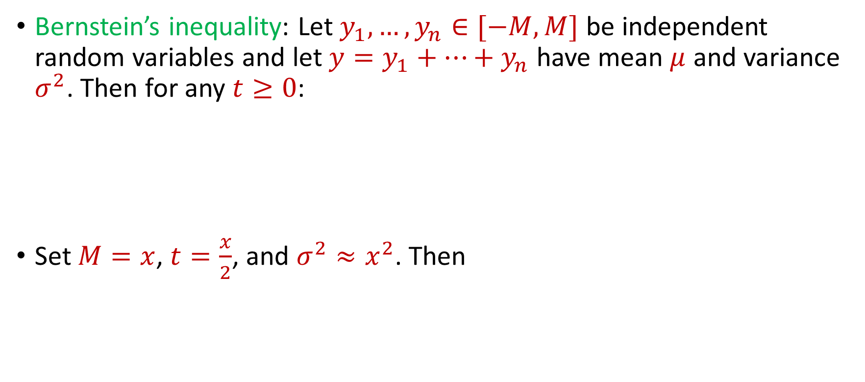
Importance Sampling for Sum Estimation
Bernstein’s inequality: Let $y_{1},…,y_{n}∈[−M,M]$ be independent random variables and let ${y=y}_{1}+…+y_{n}$ have mean $μ$ and variance $σ^{2}$. Then for any $t≥0$:
Set $M=x$, $t=\frac{x}{2}$, and $σ^{2}≈x^{2}$. Then
$$Pr\left[\left|y−μ\right|≥t\right]≤2e^{−\frac{t^{2}}{2σ^{2}+\frac{4}{3}Mt}}$$
$$Pr\left[\left|y−μ\right|≥\frac{x}{2}\right]≤2exp\left(−\frac{{\left(x/2\right)}^{2}}{2x^{2}+(4/3)(x^{2}/2)}\right)$$

Slide 44
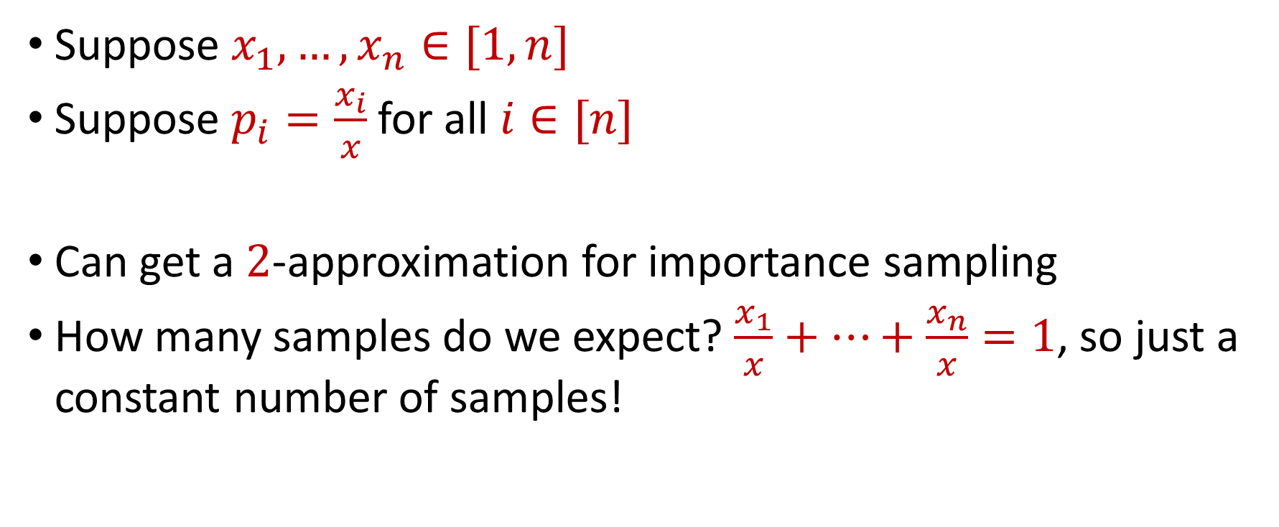
Importance Sampling for Sum Estimation
Suppose $x_{1},…,x_{n}∈[1,n]$
Suppose $p_{i}=\frac{x_{i}}{x}$ for all $i∈[n]$
Can get a $2$-approximation for importance sampling
How many samples do we expect? $\frac{x_{1}}{x}+…+\frac{x_{n}}{x}=1$, so just a constant number of samples!

Slide 45
Coreset Construction and Sampling
Consider a fixed set $X$ and a fixed set $C$ of $k$ centers, which induces a fixed cost $Cost(X,C)$

Slide 46
Coreset Construction and Sampling
Consider a fixed set $X$ and a fixed set $C$ of $k$ centers, which induces a fixed cost $Cost(X,C)$
A simple way to obtain $X′$with $Cost\left(X^{′},C\right)≈Cost(X,C)$ is to uniformly sample points of $X$ into $X′$

Slide 47
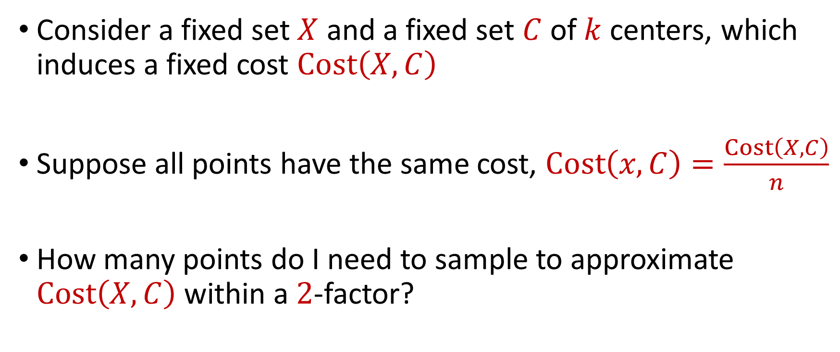
Coreset Construction and Uniform Sampling
Consider a fixed set $X$ and a fixed set $C$ of $k$ centers, which induces a fixed cost $Cost\left(X,C\right)$
Suppose all points have the same cost, $Cost\left(x,C\right)=\frac{Cost\left(X,C\right)}{n}$
How many points do I need to sample to approximate $Cost\left(X,C\right)$ within a $2$-factor?

Slide 48
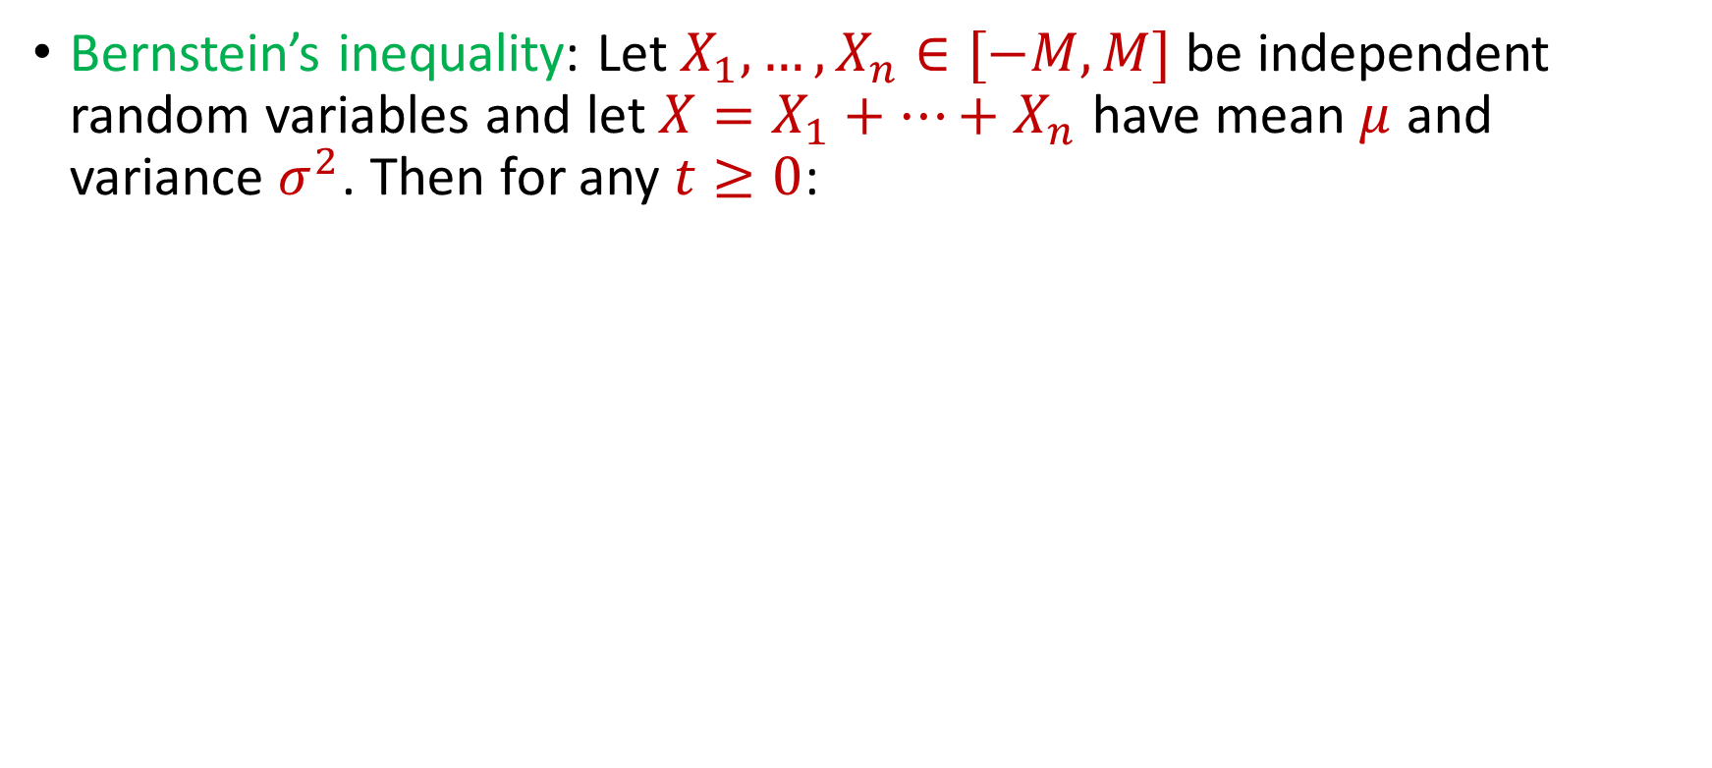
Previously: Bernstein’s Inequality
Bernstein’s inequality: Let $X_{1},…,X_{n}∈[−M,M]$ be independent random variables and let ${X=X}_{1}+…+X_{n}$ have mean $μ$ and variance $σ^{2}$. Then for any $t≥0$:
$$Pr\left[\left|X−μ\right|≥t\right]≤2e^{−\frac{t^{2}}{2σ^{2}+\frac{4}{3}Mt}}$$

Slide 49

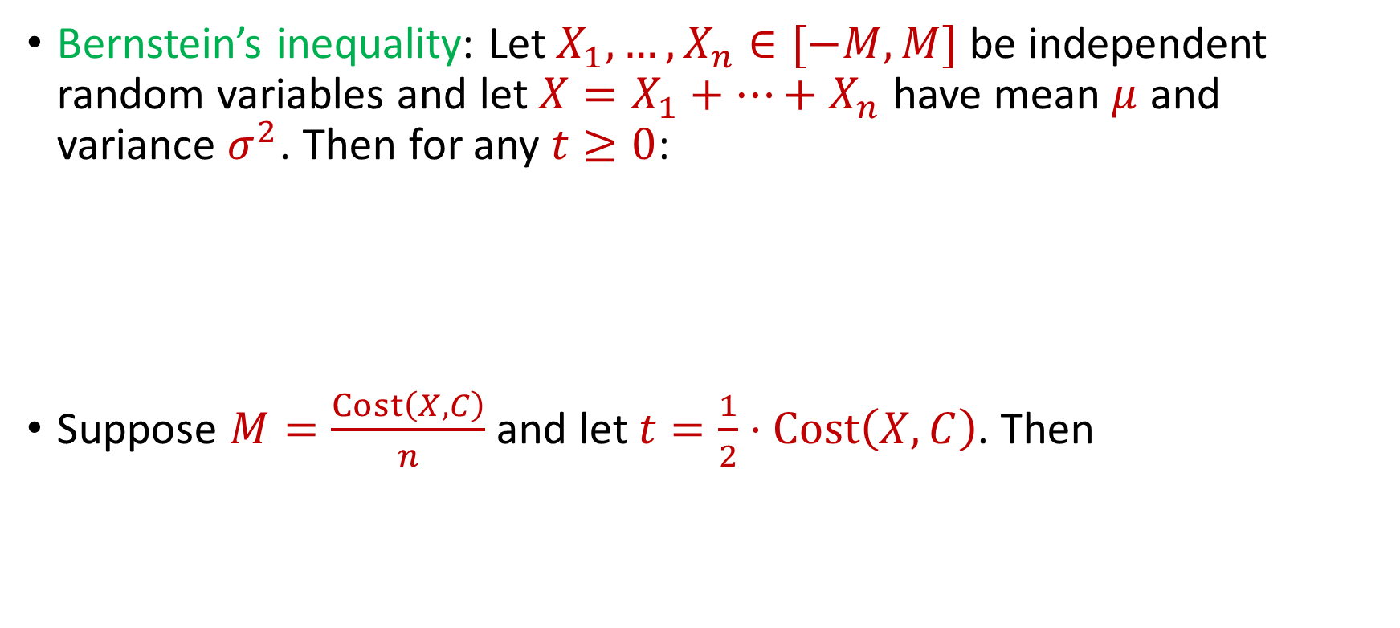
Previously: Bernstein’s Inequality
Bernstein’s inequality: Let $X_{1},…,X_{n}∈[−M,M]$ be independent random variables and let ${X=X}_{1}+…+X_{n}$ have mean $μ$ and variance $σ^{2}$. Then for any $t≥0$:
Suppose $M=\frac{Cost\left(X,C\right)}{n}$ and let $t=\frac{1}{2}⋅Cost\left(X,C\right)$. Then
$$Pr\left[\left|X−μ\right|≥t\right]≤2e^{−\frac{t^{2}}{2σ^{2}+\frac{4}{3}Mt}}$$
$$Pr\left[\left|X−μ\right|≥t\right]≤2exp\left(−\frac{3n}{8}\right)$$

Slide 50
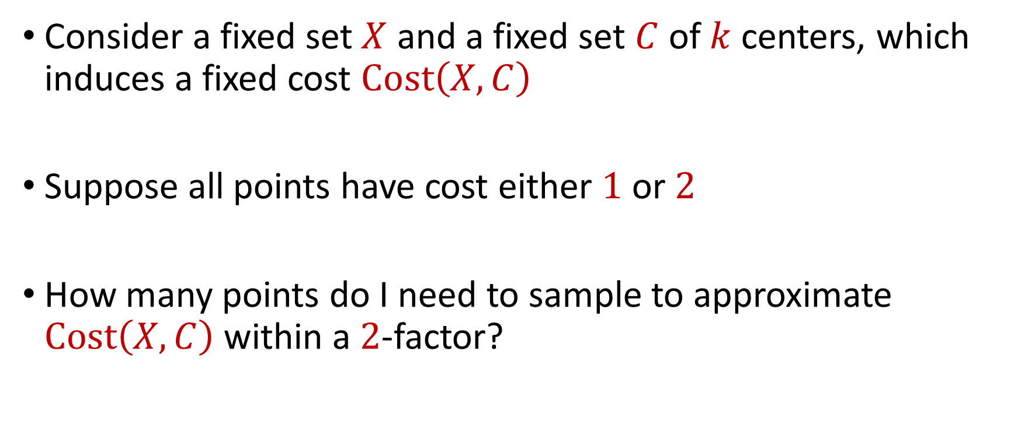
Coreset Construction and Uniform Sampling
Consider a fixed set $X$ and a fixed set $C$ of $k$ centers, which induces a fixed cost $Cost\left(X,C\right)$
Suppose all points have cost either $1$ or $2$
How many points do I need to sample to approximate $Cost\left(X,C\right)$ within a $2$-factor?

Slide 51
Previously: Bernstein’s Inequality
Bernstein’s inequality: Let $X_{1},…,X_{n}∈[−M,M]$ be independent random variables and let ${X=X}_{1}+…+X_{n}$ have mean $μ$ and variance $σ^{2}$. Then for any $t≥0$:
$$Pr\left[\left|X−μ\right|≥t\right]≤2e^{−\frac{t^{2}}{2σ^{2}+\frac{4}{3}Mt}}$$

Slide 52


Previously: Bernstein’s Inequality
Bernstein’s inequality: Let $X_{1},…,X_{n}∈[−M,M]$ be independent random variables and let ${X=X}_{1}+…+X_{n}$ have mean $μ$ and variance $σ^{2}$. Then for any $t≥0$:
Suppose $M=\frac{2Cost\left(X,C\right)}{n}$ and let $t=\frac{1}{2}⋅Cost\left(X,C\right)$. Then
$$Pr\left[\left|X−μ\right|≥t\right]≤2e^{−\frac{t^{2}}{2σ^{2}+\frac{4}{3}Mt}}$$
$$Pr\left[\left|X−μ\right|≥t\right]≤2exp\left(−\frac{3n}{16}\right)$$

Slide 53

Coreset Construction and Uniform Sampling
Consider a fixed set $X$ and a fixed set $C$ of $k$ centers, which induces a fixed cost $Cost\left(X,C\right)$
Suppose all points have cost $1$ and $M$
How many points do I need to sample to approximate $Cost\left(X,C\right)$ within a $2$-factor?

Slide 54
Previously: Bernstein’s Inequality
Bernstein’s inequality: Let $X_{1},…,X_{n}∈[−M,M]$ be independent random variables and let ${X=X}_{1}+…+X_{n}$ have mean $μ$ and variance $σ^{2}$. Then for any $t≥0$:
$$Pr\left[\left|X−μ\right|≥t\right]≤2e^{−\frac{t^{2}}{2σ^{2}+\frac{4}{3}Mt}}$$

Slide 55
Previously: Bernstein’s Inequality
Bernstein’s inequality: Let $X_{1},…,X_{n}∈[−M,M]$ be independent random variables and let ${X=X}_{1}+…+X_{n}$ have mean $μ$ and variance $σ^{2}$. Then for any $t≥0$:
Suppose $M=\frac{2Cost\left(X,C\right)}{n}$ and let $t=\frac{1}{2}⋅Cost\left(X,C\right)$. Then
$$Pr\left[\left|X−μ\right|≥t\right]≤2e^{−\frac{t^{2}}{2σ^{2}+\frac{4}{3}Mt}}$$
$$Pr\left[\left|X−μ\right|≥t\right]≤2exp\left(−\frac{3n}{16}\right)$$

Slide 56

Coreset Construction and Uniform Sampling
Consider a fixed set $X$ and a fixed set $C$ of $k$ centers, which induces a fixed cost $Cost\left(X,C\right)$
Suppose all points have cost between $1$ and $n$
How many points do I need to sample to approximate $Cost\left(X,C\right)$ within a $\left(1+ε\right)$-factor?

Slide 57
Coreset Construction and Sampling
Consider a fixed set $X$ and a fixed set $C$ of $k$ centers, which induces a fixed cost $Cost(X,C)$
Uniform sampling needs a lot of samples if there is a single point that greatly contributes to $Cost(X,C)$

Slide 58
Coreset Construction and Sampling
Fix: Importance sampling, sample each point $x∈X$ into $X′$ with probability proportional $Cost(x,C)$, i.e., $Cost(x,C)/Cost(X,C)$

Slide 59
Coreset Construction and Sampling
Fix: Importance sampling, sample each point $x∈X$ into $X′$ with probability proportional $Cost(x,C)$, i.e., $Cost(x,C)/Cost(X,C)$
Importance sampling only needs $X′$ to have size $O\left(\frac{1}{ε^{2}}\right)$ to achieve $\left(1+ε\right)$-approximation to $Cost(X,C)$

Slide 60
Coreset Construction and Sampling
Importance sampling only needs $X′$ to have size $O\left(\frac{1}{ε^{2}}\right)$ to achieve $\left(1+ε\right)$-approximation to $Cost(X,C)$
What about a different choice $C$ of $k$ centers?

Slide 61
Coreset Construction and Sampling
Importance sampling only needs $X′$ to have size $O\left(\frac{1}{ε^{2}}\right)$ to achieve $\left(1+ε\right)$-approximation to $Cost(X,C)$
To handle all possible sets of $k$ centers:
Need to sample each point $x$ with probability $\max_{C}\frac{Cost\left(x,C\right)}{Cost\left(X,C\right)}$ instead of $\frac{Cost\left(x,C\right)}{Cost\left(X,C\right)}$
Need to union bound over a net of all possible sets of $k$ centers

Slide 62
Coreset Construction and Sampling
Importance sampling only needs $X′$ to have size $O\left(\frac{1}{ε^{2}}\right)$ to achieve $\left(1+ε\right)$-approximation to $Cost(X,C)$
To handle all possible sets of $k$ centers:
Need to sample each point $x$ with probability $\max_{C}\frac{Cost\left(x,C\right)}{Cost\left(X,C\right)}$ instead of $\frac{Cost\left(x,C\right)}{Cost\left(X,C\right)}$
Need to union bound over a net of all possible sets of $k$ centers
Net with size ${\left(\frac{nΔ}{ε}\right)}^{O(kd)}$

Slide 63
Sensitivity Sampling
The quantity $s\left(x\right)=\max_{C}\frac{Cost\left(x,C\right)}{Cost\left(X,C\right)}$ is called the sensitivity of $x$ and intuitively measures how “important” the point $x$ is
The total sensitivity of $X$ is $\sum_{x∈X}{s(x)}$ and quantifies how many points will be sampled into $X′$ through importance/sensitivity sampling (before the union bound)

Slide 64

$$s\left(x_{t}\right)=\max_{C:\left|C\right|≤k}{\frac{Cost\left(x_{t},C\right)}{Cost\left(X,C\right)}}=\max_{C:\left|C\right|≤k}{\frac{Cost\left(x_{t},C\right)}{\sum_{i=1}^{n}{Cost\left(x_{i},C\right)}}}$$

Slide 65
$$s\left(x_{t}\right)=\max_{C:\left|C\right|≤k}{\frac{Cost\left(x_{t},C\right)}{Cost\left(X,C\right)}}=\max_{C:\left|C\right|≤k}{\frac{Cost\left(x_{t},C\right)}{\sum_{i=1}^{n}{Cost\left(x_{i},C\right)}}}$$
Point has sensitivity $1$

Slide 66
$$s\left(x_{t}\right)=\max_{C:\left|C\right|≤k}{\frac{Cost\left(x_{t},C\right)}{Cost\left(X,C\right)}}=\max_{C:\left|C\right|≤k}{\frac{Cost\left(x_{t},C\right)}{\sum_{i=1}^{n}{Cost\left(x_{i},C\right)}}}$$
Point has sensitivity $1$
Point has sensitivity $1$

Slide 67
$$s\left(x_{t}\right)=\max_{C:\left|C\right|≤k}{\frac{Cost\left(x_{t},C\right)}{Cost\left(X,C\right)}}=\max_{C:\left|C\right|≤k}{\frac{Cost\left(x_{t},C\right)}{\sum_{i=1}^{n}{Cost\left(x_{i},C\right)}}}$$
Point has sensitivity $1$
Point has sensitivity $1$
Point has sensitivity $1$

Slide 68
$$s\left(x_{t}\right)=\max_{C:\left|C\right|≤k}{\frac{Cost\left(x_{t},C\right)}{Cost\left(X,C\right)}}=\max_{C:\left|C\right|≤k}{\frac{Cost\left(x_{t},C\right)}{\sum_{i=1}^{n}{Cost\left(x_{i},C\right)}}}$$
Point has sensitivity $1$
Point has sensitivity $1$
Point has sensitivity $1$
Point has sensitivity $1$

Slide 69
$$s\left(x_{t}\right)=\max_{C:\left|C\right|≤k}{\frac{Cost\left(x_{t},C\right)}{Cost\left(X,C\right)}}=\max_{C:\left|C\right|≤k}{\frac{Cost\left(x_{t},C\right)}{\sum_{i=1}^{n}{Cost\left(x_{i},C\right)}}}$$
Point has sensitivity $1$
Point has sensitivity $1$
Point has sensitivity $1$
Point has sensitivity $1$
Point has sensitivity $1$

Slide 70
$$s\left(x_{t}\right)=\max_{C:\left|C\right|≤k}{\frac{Cost\left(x_{t},C\right)}{Cost\left(X,C\right)}}=\max_{C:\left|C\right|≤k}{\frac{Cost\left(x_{t},C\right)}{\sum_{i=1}^{n}{Cost\left(x_{i},C\right)}}}$$
Point has sensitivity $1$
Point has sensitivity $1$
Point has sensitivity $1$
Point has sensitivity $1$
Point has sensitivity $1$
Point has sensitivity $1$

Slide 71
$$s\left(x_{t}\right)=\max_{C:\left|C\right|≤k}{\frac{Cost\left(x_{t},C\right)}{Cost\left(X,C\right)}}=\max_{C:\left|C\right|≤k}{\frac{Cost\left(x_{t},C\right)}{\sum_{i=1}^{n}{Cost\left(x_{i},C\right)}}}$$
Point has sensitivity $1$
Point has sensitivity $1$
Point has sensitivity $1$
Point has sensitivity $1$
Point has sensitivity $1$
Point has sensitivity $1$
Point has sensitivity $1$

Slide 72
Sum of Online Sensitivity
Sum of online sensitivities can be at least $k$
How large can it be?

Slide 73
$$s\left(x_{t}\right)=\max_{C:\left|C\right|≤k}{\frac{Cost\left(x_{t},C\right)}{Cost\left(X,C\right)}}=\max_{C:\left|C\right|≤k}{\frac{Cost\left(x_{t},C\right)}{\sum_{i=1}^{n}{Cost\left(x_{i},C\right)}}}$$

Slide 74
$$s\left(x_{t}\right)=\max_{C:\left|C\right|≤k}{\frac{Cost\left(x_{t},C\right)}{Cost\left(X,C\right)}}=\max_{C:\left|C\right|≤k}{\frac{Cost\left(x_{t},C\right)}{\sum_{i=1}^{n}{Cost\left(x_{i},C\right)}}}$$

Slide 75
$$s\left(x_{t}\right)=\max_{C:\left|C\right|≤k}{\frac{Cost\left(x_{t},C\right)}{Cost\left(X,C\right)}}=\max_{C:\left|C\right|≤k}{\frac{Cost\left(x_{t},C\right)}{\sum_{i=1}^{n}{Cost\left(x_{i},C\right)}}}$$

Slide 76
$$s\left(x_{t}\right)=\max_{C:\left|C\right|≤k}{\frac{Cost\left(x_{t},C\right)}{Cost\left(X,C\right)}}=\max_{C:\left|C\right|≤k}{\frac{Cost\left(x_{t},C\right)}{\sum_{i=1}^{n}{Cost\left(x_{i},C\right)}}}$$

Slide 77
$$s\left(x_{t}\right)=\max_{C:\left|C\right|≤k}{\frac{Cost\left(x_{t},C\right)}{Cost\left(X,C\right)}}=\max_{C:\left|C\right|≤k}{\frac{Cost\left(x_{t},C\right)}{\sum_{i=1}^{n}{Cost\left(x_{i},C\right)}}}$$
Partition the sum of the sensitivities by each cluster

Slide 78
$$s\left(x_{t}\right)=\max_{C:\left|C\right|≤k}{\frac{Cost\left(x_{t},C\right)}{Cost\left(X,C\right)}}=\max_{C:\left|C\right|≤k}{\frac{Cost\left(x_{t},C\right)}{\sum_{i=1}^{n}{Cost\left(x_{i},C\right)}}}$$
Charge to $OPT$
Charge to $OPT$

Slide 79

Sum of Online Sensitivity
Intuition: The sum of the sensitivities in each cluster induced by $OPT$ is at most $1$
Since there are $k$ clusters, the sum of the sensitivities is $O_{z}(k)$

Slide 80


census.gov:

Slide 81


Private Data Analysis
Sensitive dataset
Analyst
Analysis of medical datasets to predict possible issues
Pattern detection for social networks or epidemic spread
US Census information for apportionment

Slide 82

Anonymization
Sensitive dataset
Anonymized dataset
Analyst

Slide 83
Anonymizing Data
Age | Zip Code | Employer | Has Pet
56 | 77005 | Apple | Yes
32 | 77005 | Microsoft | No
71 | 77005 | Amazon | Yes
44 | 77005 | Petsmart | Yes
25 | 77005 | Netflix | No
61 | 77005 | Google | No

Slide 84
Anonymizing Data
Age | Zip Code | Employer | Has Pet
56 | 77005 | Apple | Yes
32 | 77005 | Microsoft | No
71 | 77005 | Amazon | Yes
44 | 77005 | Petsmart | Yes
25 | 77005 | Netflix | No
61 | 77005 | Google | No
Name | Age | Gender | Employer
Alice | 56 | Female | Apple
Bob | 32 | Male | Microsoft
Carol | 71 | Female | Amazon
Dale | 44 | Male | Petsmart
Erin | 25 | Female | Netflix
Fred | 61 | Male | Google

Slide 85
Reconstruction Attack
Name | Age | Zip Code | Gender | Employer | Has Pet
Alice | 56 | 77005 | Female | Apple | Yes
Bob | 32 | 77005 | Male | Microsoft | No
Carol | 71 | 77005 | Female | Amazon | Yes
Dale | 44 | 77005 | Male | Petsmart | Yes
Erin | 25 | 77005 | Female | Netflix | No
Fred | 61 | 77005 | Male | Google | No

Slide 86

Anonymizing Data

Slide 87

Image from Arvind Narayanan

Slide 88
Differencing Attacks
How many people in this classroom went to Kyle Field last weekend?
How many people in this classroom besides the instructor went to Kyle Field last weekend?

Slide 89

Slide from Steven Wu

Slide 90

2010 US Census
$308,745,738$ people $×$ $6$ variables = $1,852,473,228$ measurements collected
Total statistics: $5,578,897,932$
Create a system of $5.5$ billion equations with $1.8$ billion unknowns

Slide 91


2010 US Census
Reconstruction attack on 2010 US Census by researchers recovered information for $308,745,538$ people using census block and tract summary tables

Slide 92
Summary
“Ad-hoc” privacy procedures like anonymization/deidentification often fails
Publishing too many queries on a sensitive database with too much accuracy can compromise the privacy of the database
Need a formal mathematical notion for measuring privacy

Slide 93

Possible Notion for Privacy #1
“The data analyst cannot learn anything about Alice”
Sensitive dataset
Analyst

Slide 94
Possible Notion for Privacy #1
“The data analyst cannot learn anything about Alice”
Most Aggies like Reveille
Alice is known to be an Aggie
Sensitive dataset
Analyst
Was Alice’s privacy violated?

Slide 95

Possible Notion for Privacy #1
“The data analyst cannot learn anything about Alice”
Most Aggies like Reveille
Bob participates in the survey
Sensitive dataset
Analyst
Even though Alice is not in the survey, it is still known that Alice is an Aggie

Slide 96
Possible Notion for Privacy #1
Suppose a survey is conducted on a sensitive dataset and concludes that “most Aggies like Reveille”
Alice is a known Aggie, and so a data analyst infers that Alice is more likely to be a dog owner and asks for higher apartment cleaning rates
Was Alice’s privacy violated by this study?

Slide 97
Possible Notion for Privacy #2
“A study is private…if the data analyst gains almost no additional information about Alice from the study than if the same study was performed without Alice’s data”

Slide 98

Possible Notion for Privacy #2
Stability: the data analyst reaches roughly similar conclusions if any individual data point is replaced by another data point of the population

Slide 99




Differential Privacy
[DMNS06] Given $ε>0$and $δ∈\left(0,1\right)$, a randomized algorithm $A:U^{∗}→Y$ is $(ε,δ)$-differentially private if, for every neighboring frequency vectors $f$ and $f′$ and for all $E⊆Y$,
$$Pr\left[A\left(f\right)∈E\right]≤e^{ε}Pr\left[A\left(f^{′}\right)∈E\right]+δ$$
$$A\left( \right)≈A\left( \right)$$
Notes:
[DworkMcSherryNissimSmith06]

Slide 100

Differential Privacy
[DMNS06] Given $ε>0$and $δ∈\left(0,1\right)$, a randomized algorithm $A:U^{∗}→Y$ is $(ε,δ)$-differentially private if, for every neighboring frequency vectors $f$ and $f′$ and for all $E⊆Y$,
$$Pr\left[A\left(f\right)∈E\right]≤e^{ε}Pr\left[A\left(f^{′}\right)∈E\right]+δ$$
Sensitive dataset
Algorithm
Output distribution
Notes:
[DworkMcSherryNissimSmith06]

